Slide 1

Navigating Zero Trust with your own AI Copilot: Your Security Wingman takes flight!

Slide 2


Slide 3

Agenda
Phishing Resistant Authentication
What, Why and How?
Do you have control over Groups?
Groups can be dangerous if not managed properly
Entra ID Assistant – your own copilot
MCPs, LLMs, APIs, and chatbot
Image: Microsoft PowerPoint stock images

Slide 4

Phishing Resistant Authentication

Slide 5

Phishing Resistant Authentication
Microsoft Entra data shows password-based attacks make up over 99% of the 600 million daily identity attacks
No More Password Nightmares
Superhero Level Security
Time Saver Extraordinaire
FIDO, Passkeys or Windows Hello
Image: Microsoft PowerPoint stock images

Slide 6

How to & Best Practices
Authentication Methods
Conditional Access Policies
Policy as Code [using Terraform]
Report Only mode and analyze impact
Rollout Plan – In phases
Communication is the Key
Image: Microsoft PowerPoint stock images

Slide 7

Corner Cases
What is my Authentication does not work?
App Exclusions
Image: Microsoft PowerPoint stock images

Slide 8

Do you have control over Groups?
Image: Microsoft PowerPoint stock images

Slide 9

Control over Groups?
Group Administrator, Group Owners or any Identity ( User or Service principal) with Group.Write permissions are as strong as Global Admins.
Major Impact on Conditional Access Policies and
Enterprise Application assignments.
Conditional Access Policy Changes – Alerts.
But have you got the Groups covered as well?
Image: Microsoft PowerPoint stock images

Slide 10
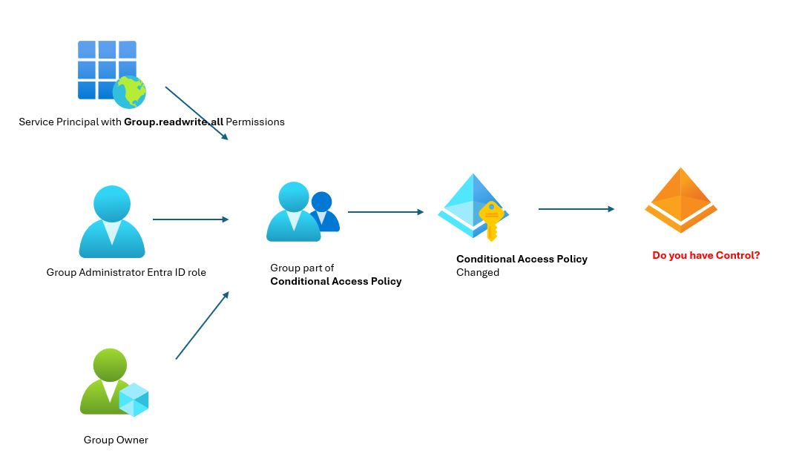
Do you have control over Groups?

Slide 11
Monitor your Groups!
Alert on Group changes using Microsoft Sentinel
Break glass account – never in Groups
Restricted Management Administrative Units

Slide 12
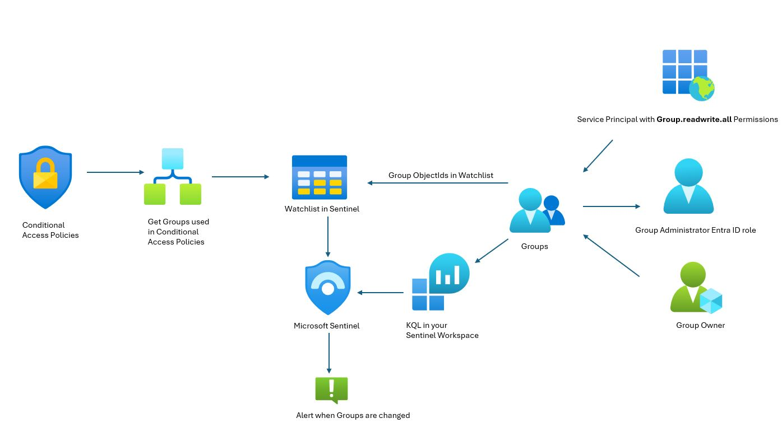
Monitor your Groups!

Slide 13
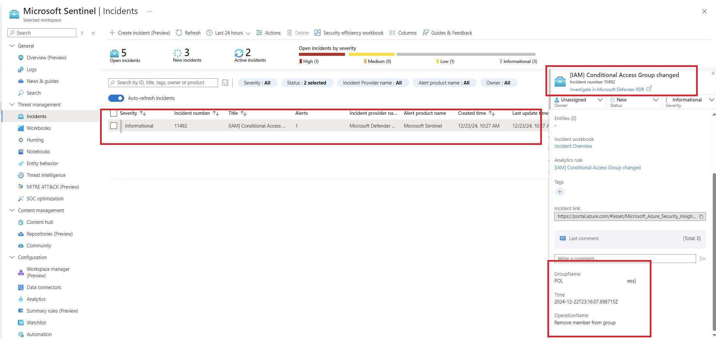
Monitor your Groups!

Slide 14
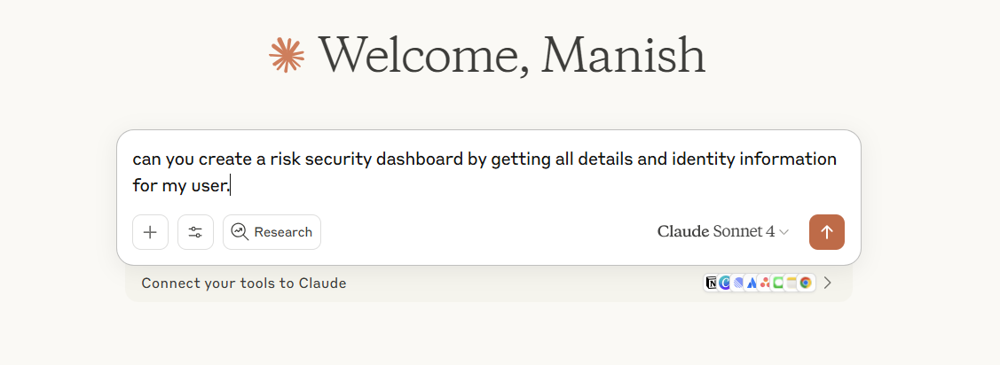
Entra ID Assistant – User Risk / Security Dashboard

Slide 15
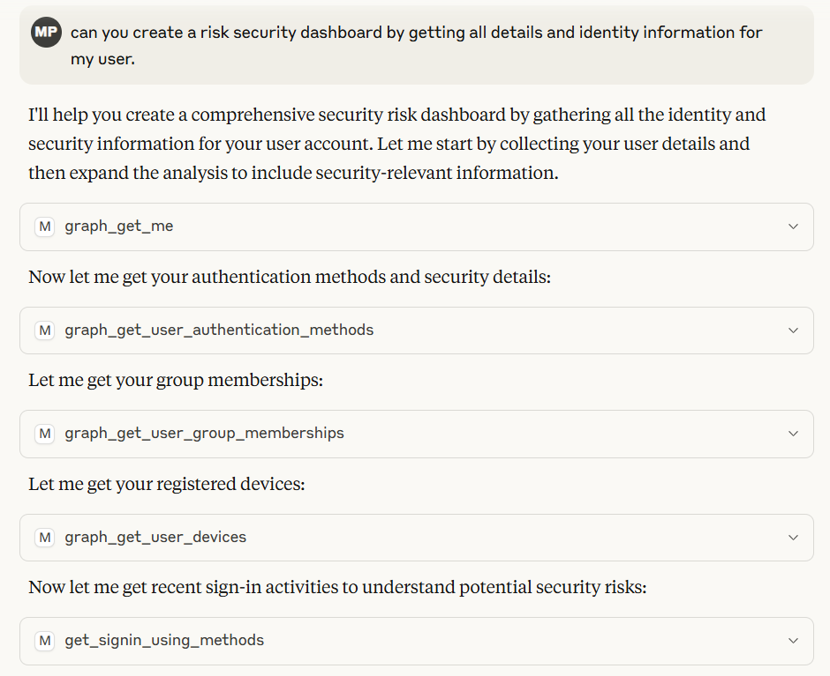
Entra ID Assistant – User Risk / Security Dashboard

Slide 16
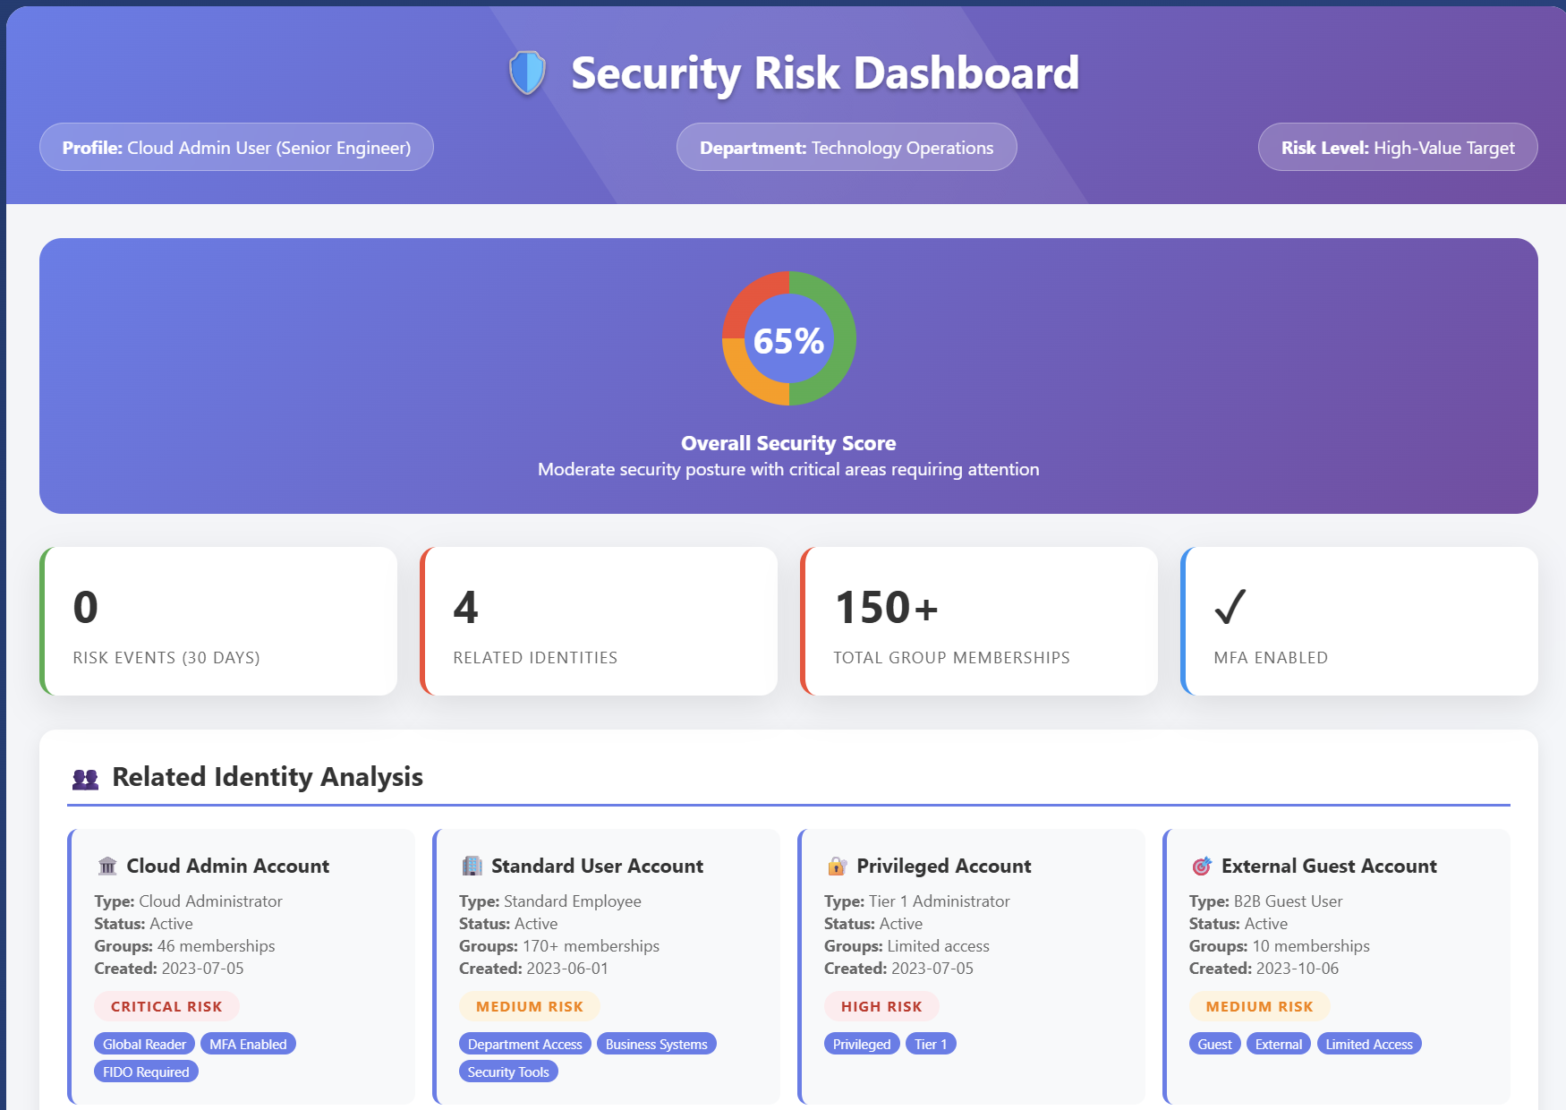
Entra ID Assistant – User Risk / Security Dashboard

Slide 17
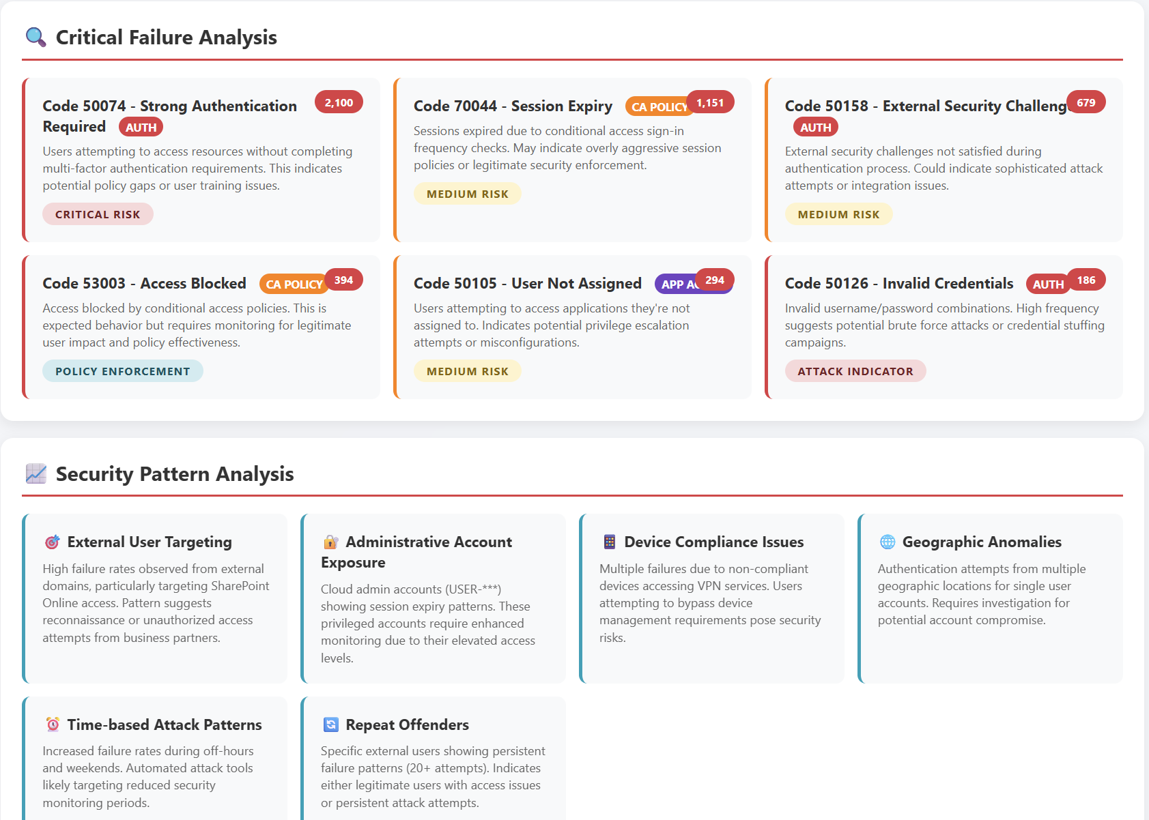
Entra ID Assistant – Sign-in Failures

Slide 18






Entra ID Assistant – The architecture
4.
3.
5.
6.
8.
7.
2.
1.

Slide 19
DEMO

Slide 20
Questions?

