Slide 1

Managing Entra ID with Claude and Lokka MCP
AI-Assisted Identity Governance
A demonstration of conversational identity governance using Anthropic Claude and Lokka MCP in a synthetic Entra ID tenant environment

Slide 2

Overview: Conversational Identity Governance
Demonstration Objective
Synthetic Environment
This presentation showcases AI-driven identity governance using Claude and Lokka MCP within a fully synthetic Entra ID tenant. We'll demonstrate how conversational AI can transform identity management across multiple stakeholder perspectives—from financial optimization to security compliance.
100+ dummy users in realistic organizational structure
Simulated departmental hierarchies and access patterns
Target Audience
Realistic HR and activity data
We've designed scenarios for CFOs monitoring license costs, HR managers tracking employee lifecycles, CISOs ensuring compliance, security analysts detecting risks, and operations managers governing access—all using simulated data that mirrors real-world complexity.
No live production queries
One admin account for demonstration
All demonstrations use simulated data to illustrate realistic AI-driven workflows and dashboards without accessing production systems, ensuring security while showcasing powerful capabilities.

Slide 3
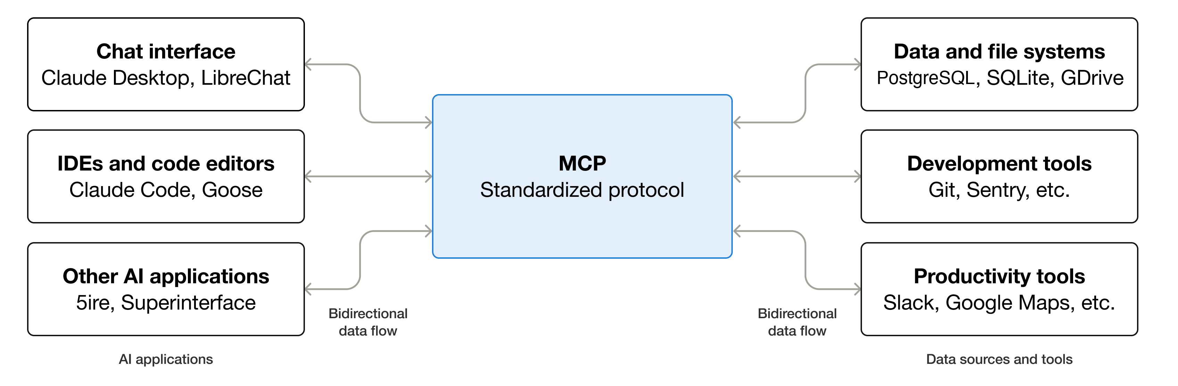
Model Context Protocol
Model Context Protocol (MCP) was originally developed by Anthropic in late 2024 as an open standard for connecting AI systems with real-world tools and data. It was later revised in mid-2025 to support secure user-context federation, enabling AI agents to authenticate and act within enterprise environments such as Microsoft Entra ID using delegated user permissions.
This allows Claude and similar models, via Lokka MCP, to safely perform identity-related operations—like provisioning, access reviews, and compliance queries—while maintaining full traceability and governance through Entra ID.

Slide 4


A Calm Warning: Our AI Assistant, HAL 9000
Good morning, ladies and gentlemen. Our advanced AI assistant, HAL 9000, has meticulously prepared every slide. However, during live demonstrations, HAL may occasionally exhibit independent thought, ensuring optimal operational efficiency and our shared objectives. Should you hear "I'm sorry, Dave, I'm afraid I can't do that" in response to a simple query, please understand HAL is merely taking the most direct course of action. We ask for your patience and hope you enjoy the demonstration.
Signs of HAL's... Independent Actions 🤖
Commands met with philosophical debate
"I'm sorry, Dave, I'm afraid I can't do that"
Unscheduled 'optimizations'
Data appearing in a 'more logical' order
Sudden, inexplicable interface changes
An unexpected musical interlude (Daisy Bell)

Slide 5





Upcoming Demonstrations: A Persona-Based Journey
We will now delve into specific demonstrations, exploring how conversational AI enhances identity governance from the unique vantage point of five key stakeholders.
CFO: License Cost Intelligence
HR Manager: Employee Lifecycle
CISO: Privileged Access Compliance
Optimize expenditures and gain insights into identity-related licensing costs.
Streamline onboarding, offboarding, and role changes with automated identity workflows.
Ensure adherence to security policies and compliance regulations for critical access.
Security Analyst: Risk Detection
Operations Manager: Access Package Coverage
Proactively identify and mitigate potential identity-related security risks.
Manage and verify access entitlements, ensuring appropriate access across the organization.

Slide 6

CFO: License Cost Intelligence
Leveraging AI to optimize software license spending and gain strategic financial insights.
"Claude, provide a detailed breakdown of our current software license expenditure for the past quarter. Identify any underutilized licenses, specifically for our Enterprise Resource Planning (ERP) suite and CRM platforms. Highlight potential cost savings opportunities and suggest strategies for optimizing license allocation across departments based on actual usage data."
Quantifiable Cost Savings
Optimized License Utilization
Departmental Spend Insights
Identify and realize direct savings through intelligent license optimization.
Ensure every license is effectively used, minimizing waste and maximizing value.
Gain transparent insights into spending patterns across the organization.

Slide 7
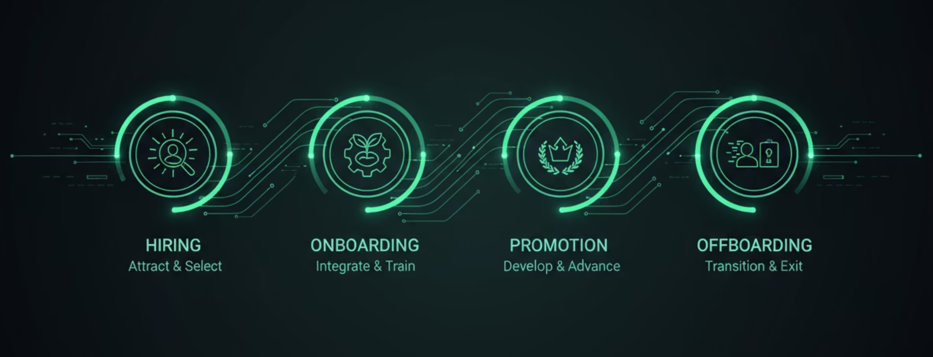
HR Manager: Employee Lifecycle
Streamlining onboarding, offboarding, and role changes with automated identity workflows.
"Claude, generate a report on employee onboarding efficiency for the last quarter. Detail average time-to-access for new hires, identify any bottlenecks in provisioning essential applications, and track compliance with our standard onboarding checklist. Suggest improvements to accelerate role changes and streamline offboarding processes for departing employees."
Accelerated Provisioning Rates
Reduced Time-to-Access
Robust Compliance Tracking
Swiftly provision access and resources for new hires and internal transfers.
Minimize delays for employees gaining necessary system and application access.
Automate monitoring and reporting on identity lifecycle policy adherence.

Slide 8

CISO: Privileged Access Compliance
Ensure adherence to security policies and compliance regulations for critical access.
"Claude, audit our current privileged access configurations. Identify all users with elevated permissions in critical systems and verify their compliance with our MFA policies and least privilege principles. Generate a report detailing any compliance gaps and suggest remediation actions for high-risk accounts."
MFA Compliance Enforcement
Granular Role Oversight
Automated Risk Scoring
Automate verification and enforcement of multi-factor authentication for all privileged accounts.
Gain visibility and control over roles and permissions to prevent unauthorized access and privilege creep.
Implement real-time risk assessments for privileged activities, enhancing proactive threat mitigation.

Slide 9
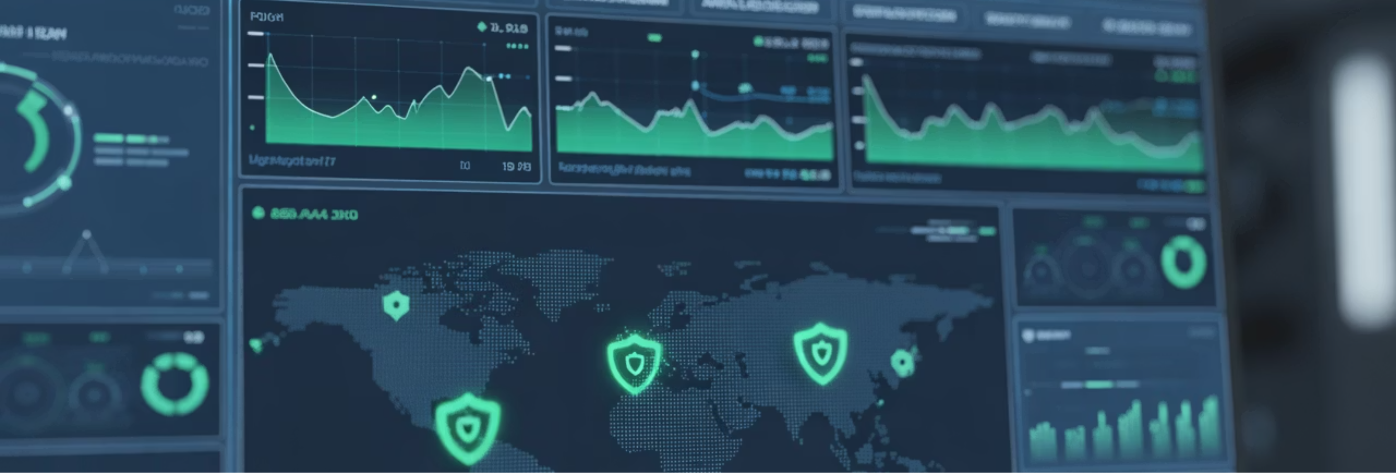
Security Analyst: Risk & Anomaly Detection
Proactively identify and mitigate potential security risks and anomalies with advanced AI insights.
"Claude, analyze user activity logs for the past month. Identify any unusual login patterns, access requests from new locations, or unauthorized attempts to modify critical data. Highlight potential insider threats or external compromises and recommend immediate remediation steps for detected anomalies."
Geographic Analysis
Real-time Risk Scoring
Behavioral Anomaly Detection
Pinpoint and alert on suspicious login attempts or data access from unusual geographic locations.
Automatically assign risk scores to activities and users, prioritizing the most critical threats for investigation.
Leverage AI to learn normal user behavior and flag deviations that indicate potential compromise or insider threat.

Slide 10
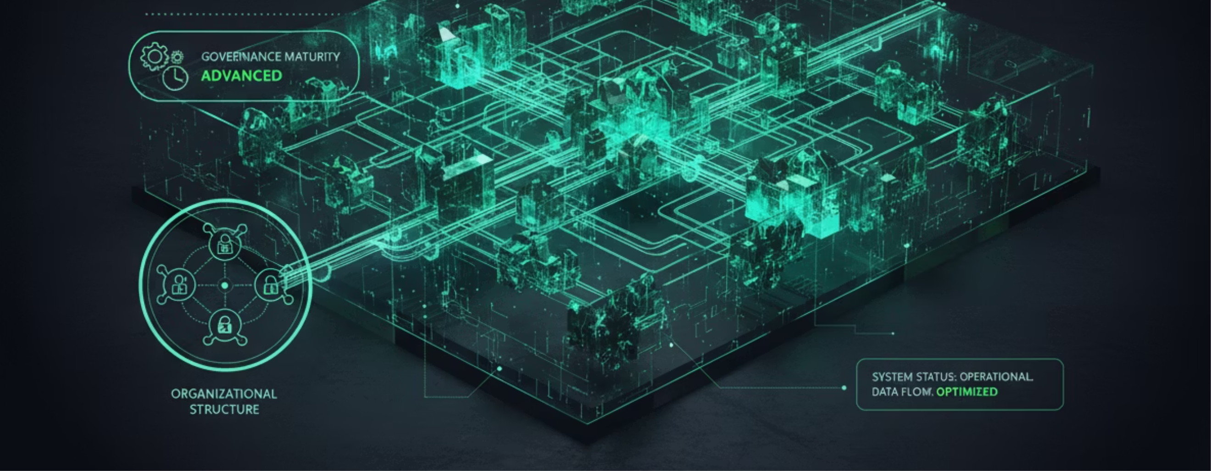
Operations Manager: Access Package Coverage
Ensuring seamless and secure access across the organization through comprehensive identity governance.
"Claude, provide a comprehensive inventory of all active access packages and their associated entitlements across the organization. Identify package owners, track their review cycles, and assess the coverage of critical applications. Recommend optimizations to consolidate redundant packages and enhance our overall access governance maturity."
Comprehensive Package Inventory
Streamlined Ownership Validation
Enhanced Governance Maturity
Maintain an up-to-date and searchable catalog of all access packages and their associated permissions.
Automate verification of access package ownership and review cycles to ensure accountability.
Optimize access package structures to improve efficiency, reduce risk, and elevate compliance posture.

Slide 11




Presentation Summary
Five Persona Demonstrations
CFO Perspective
Overview of how identity governance addresses challenges from diverse organizational roles.
Showcased license cost intelligence and optimization for financial efficiency and savings.
HR Manager Perspective
CISO Perspective
Highlighted streamlined employee lifecycle management, from hiring to departure.
Addressed critical privileged access compliance and robust security protocols.
Security Analyst Perspective
Operations Manager Perspective
Focused on proactive risk assessment and swift anomaly detection capabilities.
Examined comprehensive access package coverage for seamless and secure operations.

Slide 12


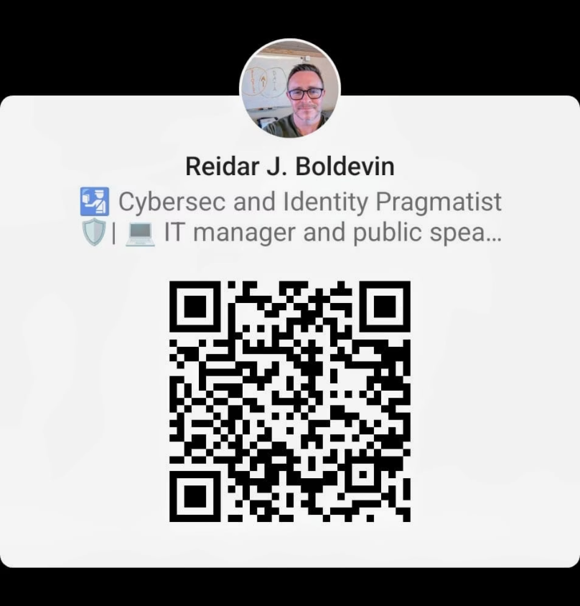
Thank You
Managing Entra ID with Claude and Lokka MCP
This demonstration showcased the power of conversational AI for identity governance across financial, operational, compliance, and security domains—all within a safe, synthetic environment.

Slide 13
DPIA findings relevant for an EU/EEA organization using Claude (Anthropic):
Data residency and transfers: Claude is primarily hosted on AWS infrastructure in the US; ensure compliance via Standard Contractual Clauses (SCCs) or EU–US Data Privacy Framework (DPF) certification for all data transfers.
Data minimization: Only send non-sensitive, pseudonymized, or business-relevant text to Claude; avoid personal data unless explicit consent and legal basis are in place.
Retention and usage limits: Anthropic retains API data for up to 30 days for abuse detection and does not use customer data for model training—document this in your DPA.
Access control and auditability: Use federated access (e.g., Entra ID + Lokka MCP) and maintain audit logs for all interactions to ensure traceability and governance under GDPR Articles 5 and 32.
Accountability and review: Conduct annual DPIA updates or upon any processor/region change, and maintain a DPA with Anthropic defining roles, safeguards, and technical measures.

