Slide 1
Introduction to Identity
A masterclass for newcomers · Identiverse 2026
Espen Bago & Lance Peterman identi.beer/intro

Slide 2


Speakers
Espen Bago
Lance Peterman
Head of IAM, Gritera Security
IdentiBeer Founder
Engineering Manager — IAM, Dick’s Sporting Goods

Slide 3

Pirate & reuse this deck
These slides are open. Take them, remix them, reuse them — no permission needed.
identi.beer/intro
and
identi.beer/intro-questions

Slide 4
Why should I care about identity?
Identity decides who can do what, where your data goes, and who is accountable when something breaks.
Those who control identity, control the business.

Slide 5
Everyone is already doing IAM
… the field just wraps it in acronyms
IAM

Slide 6
What we’ll cover today
01
02
03
04
Before the Acronyms
Objects, Subjects & Contexts
Perspectives
Governance
What identity is, before the tech
Who and what we manage
Lenses on one problem
Keeping access under control
05
06
07
08
Admin-time vs Run-time
Authentication
Authorization
AI & Identity
When decisions happen
Claim and prove
What you can do inside
The newest entity type

Slide 7

Before the Acronyms
01
SECTION 01
Why identity matters — and what we even call it.
#identiverse | 7

Slide 8
Identity is older than technology
50 people
A town, a guild, a kingdom
A digital, global economy
Everyone knows everyone. Recognition is identity management.
Letters of introduction. Seals. Signatures. Trust travels with credentials.
Identifiers. Credentials. Tokens. The same problem at impossible scale.

Slide 9
Why does identity exist in organizations?
Trust
Access
Accountability
Know who you are dealing with.
Control what entities can do.
Answering the question of:
Who does what, and why?

Slide 10
And you are already doing Identity
HR onboarding
Showing your conference badge
Programming building keycards
Identity lifecycle
Authentication
Access management
You don’t grade your own work
A manager approving an expense
Segregation of duties
Authorization

Slide 11
What got lost when we digitized
Pre-digital identity
Digital identity
“This is Erik, the blacksmith’s son, known to me, sent to collect his father’s order.”
Implicit: who, what role, on whose behalf, with what authority, in what context.
user_id: 8472, group: blacksmith_apprentices
Explicit only: identifiers and attributes. The relationships disappeared.
IAM is largely the effort to put the relationships back.

Slide 12
What’s coming next: identity at automated speed
The pressure
The blocker
Organizations can’t make every access decision manually anymore.
More users. More machines. More AI agents — decisions per second beyond any human chain of approval.
The work shifts from deciding each case to encoding policies that decide automatically.
The biggest obstacle isn’t technology — it’s data.
To automate access decisions well, you need to know: what is this person’s actual work, and what does it require?
That information almost never exists in structured form — even though we knew it when we hired them.

Slide 13
Questions to ask: Foundations
01 / 10 · FOUNDATIONS
Deepen your understanding
Challenge assumptions
What does your organization consider the core identity relationships it needs to represent? Who is accountable for keeping that current?
If you automated every access decision tomorrow, what data would you not have to do it well?

Slide 14
Objects, Subjects & Contexts
02
SECTION 02
What we protect, who acts on it, and the contexts they live in
#identiverse | 14

Slide 15
Enter: the value to be protected
Object

Slide 16
Resources: Objects of value worth protecting
Objects made available to someone
Objects managed by someone
Objects managed for someone
Objects owned by someone
Information
Money
Tools
Resources
Anything that’s limited
Anything subject to a financial transaction

Slide 17


Objects vs Subjects
Shiny Thing

Slide 18


Objects, Subjects, and Rules
?
I’m going to touch it!

Slide 19

Objects, Subjects, and Rules
No, you’re not..

Slide 20
Objects, Subjects, Rules, and Barriers

Slide 21

Objects, Subjects, Rules, Barriers, and Tokens
?
Actually, I have permission!
Figures reused from xkcd.com with permission

Slide 22
A “permission slip” in the real digital world
{
"iss": “http://idp.example.com”,
"sub": “248289761001”,
"aud": “http://sp.example.com”,
"jti": “_d71a3a8e9fcc45c9e9d248ef7049”,
"nonce": “n-0S6_WzA2Mj”,
"exp": 1311281970,
"iat": 1311280970,
"nbf": 1311280970,
"acr": “phrh”,
"amr": “face”,
"uid": “Identiverse_attendee_2026”,
}
A Bearer Token
Same idea as the stick figure’s permission slip. Different language.

Slide 23
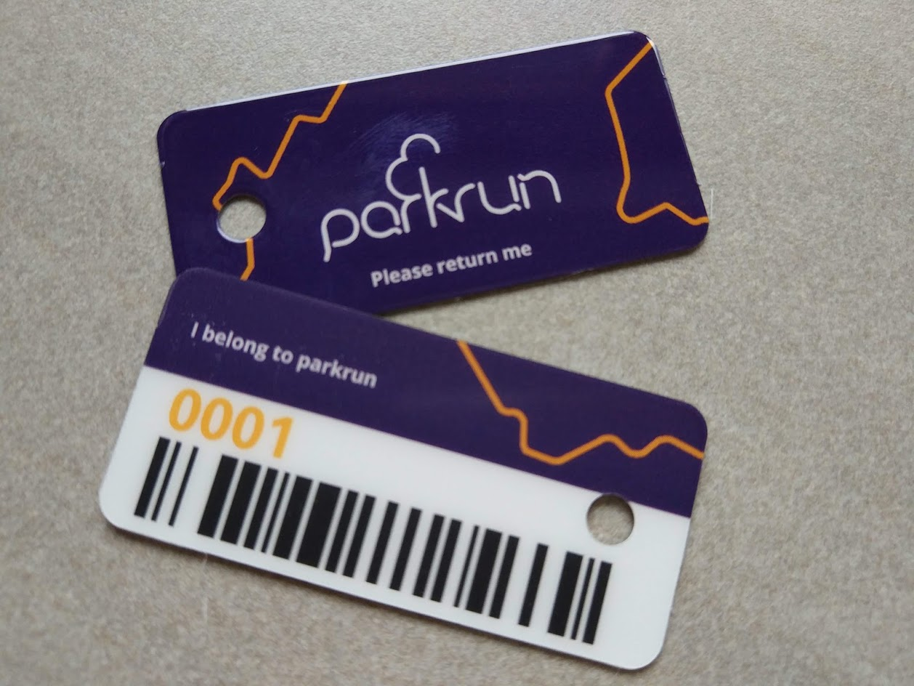
How about a real-world example?
A token. A scanner. A record. Identity in action.

Slide 24
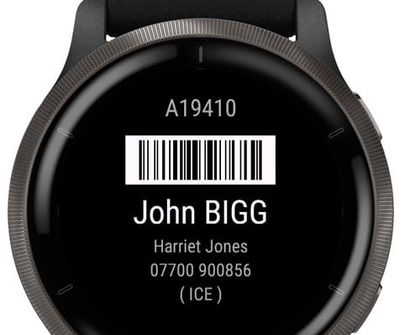
A wearable as an identifier
The same example — a token, presented to whoever scans it.

Slide 25
Identity Contexts
The same person, represented differently depending on context.

Slide 26
Me as an example
For each context there is a different set of data to collect, and different ways to collect it.
Employee
Consumer
Citizen
Volunteer
One place of employment, but many data sources.
More data than you can count…
Data about me as a potential patient. Data about me as a voter. Data about me as a taxpayer.
Blood donor data. Organizer of IdentiBeer meetups.

Slide 27
The Identity Hierarchy
PERSON Physical · Accountable (or responsible)
IDENTITY Digital · Holds governance data
SYSTEMS Has identifier and maybe credentials
ACCESS RIGHTS Often system-specific

Slide 28
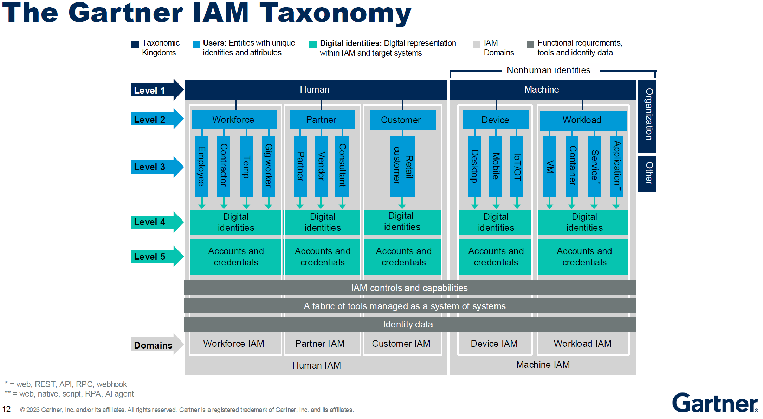
Source: Gartner, Erik Wahlstrøm

Slide 29
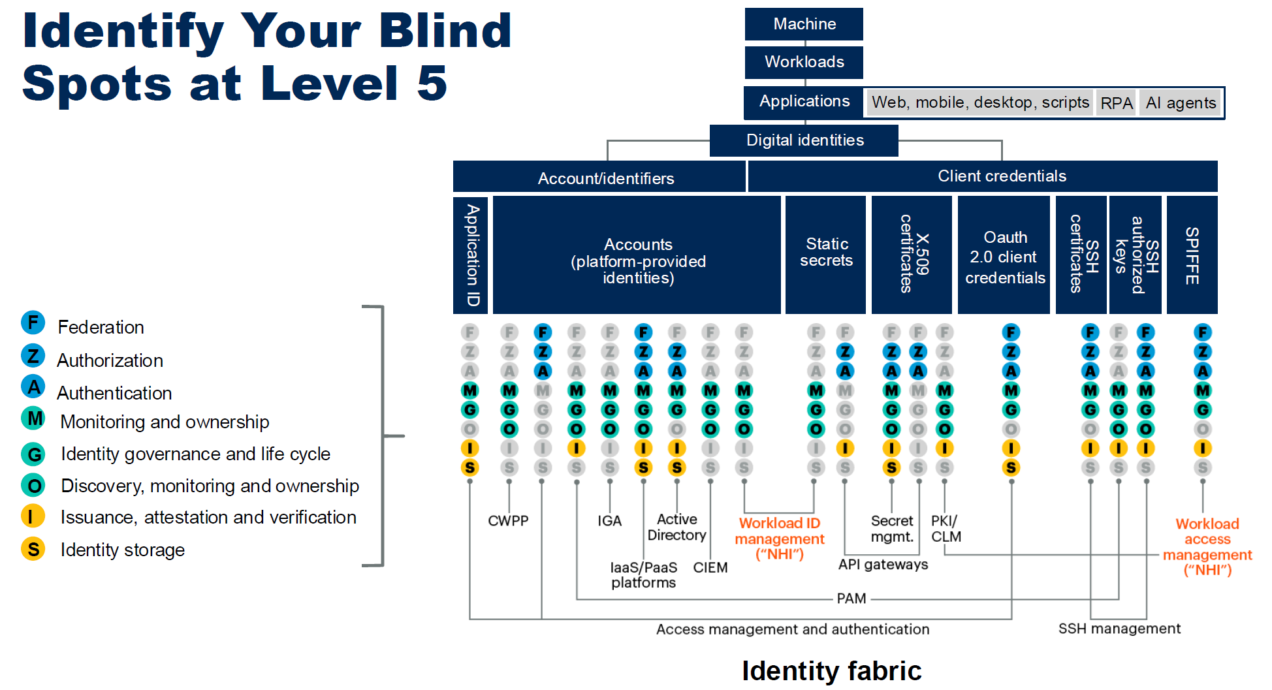

Slide 30
Persons + all the Other Users
Human
B2E — Employees → Accounts
B2B — Vendors / consultants / partners → Accounts
B2C — Customers → Accounts
Nonhuman
Machines
Devices — Desktop, Mobile, IoT/OT
Workloads — VMs, Containers
Services — web, REST APIs, RPC, webhooks
Applications — apps, scripts, service accounts, RPAs
AI agents and assistants
Organizations
Animals
Other
Source: Gartner, Erik Wahlström

Slide 31
Questions to ask: Objects & Contexts
03 / 10 · OBJECTS & CONTEXTS
Deepen your understanding
Challenge assumptions
In your organization, which identity contexts — workforce, customer, citizen, partner, machines — are managed by the same team, and which are siloed?
Are you treating the same person differently across contexts because it serves the business — or because your data is siloed and nobody noticed?

Slide 32
Perspectives
03
SECTION 03
Same field, many angles — the kaleidoscope.
#identiverse | 32

Slide 33

Anybody recognize this?
What you see depends on the angle you look from. Identity is the same.

Slide 34
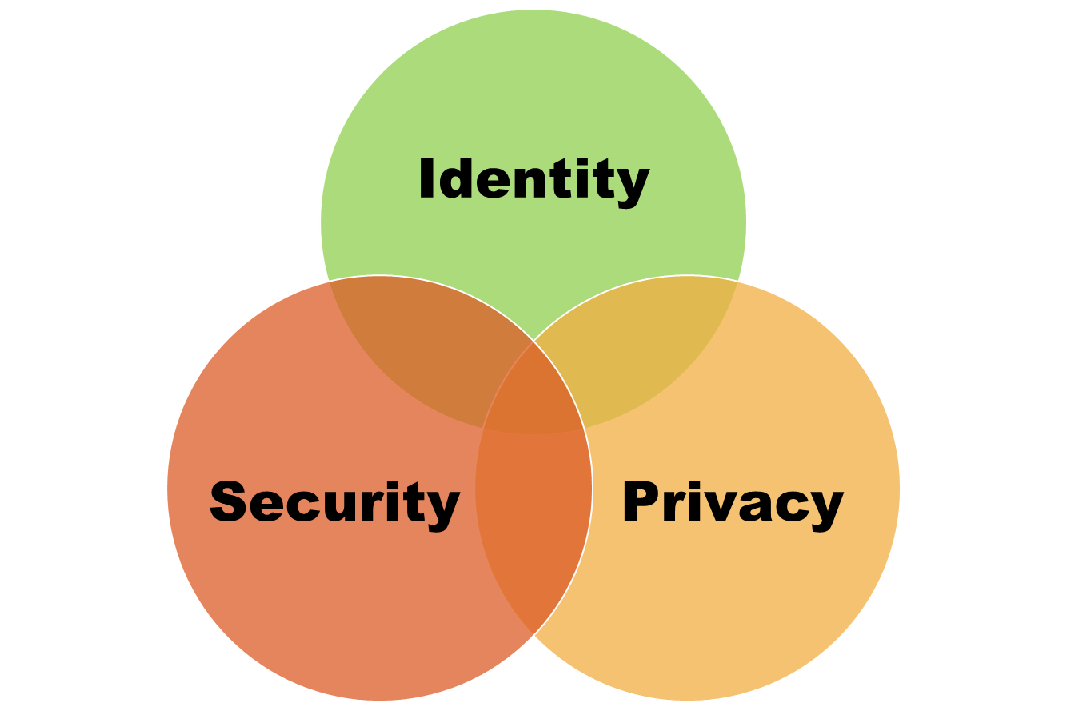
Three overlapping fields

Slide 35
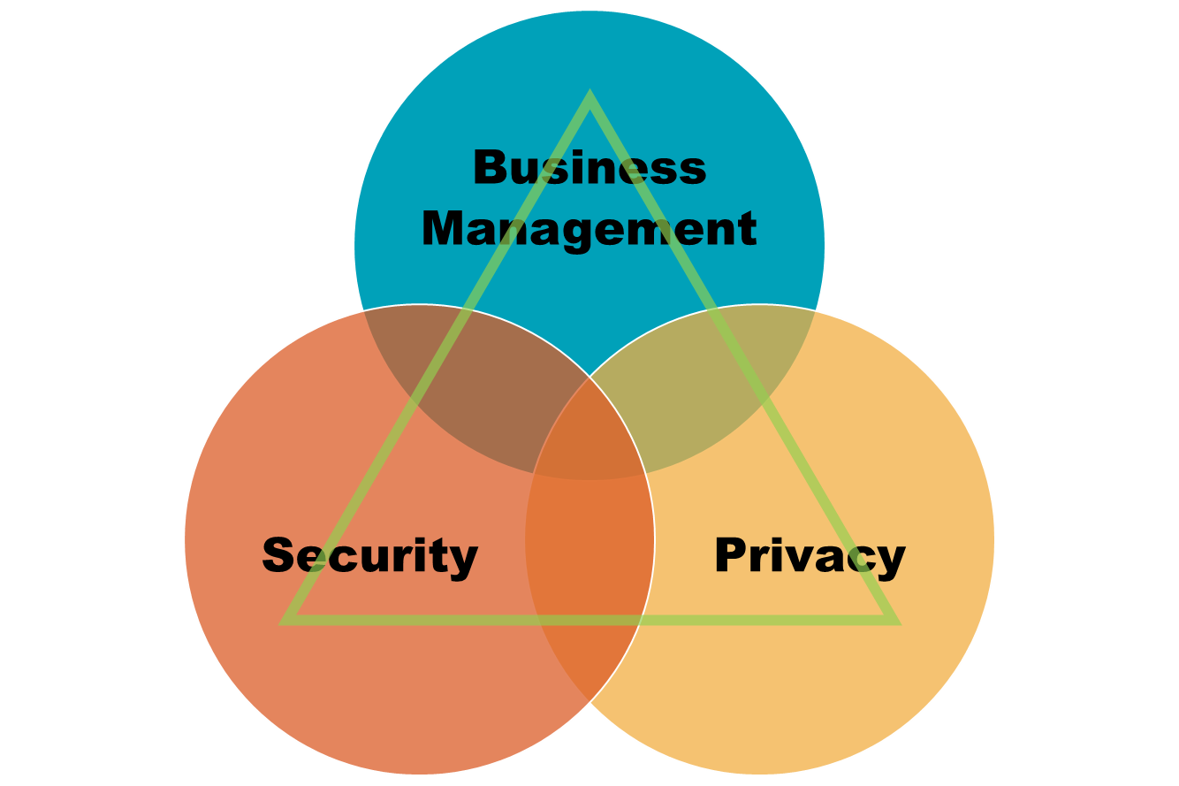
And a missing dimension
Business Management

Slide 36
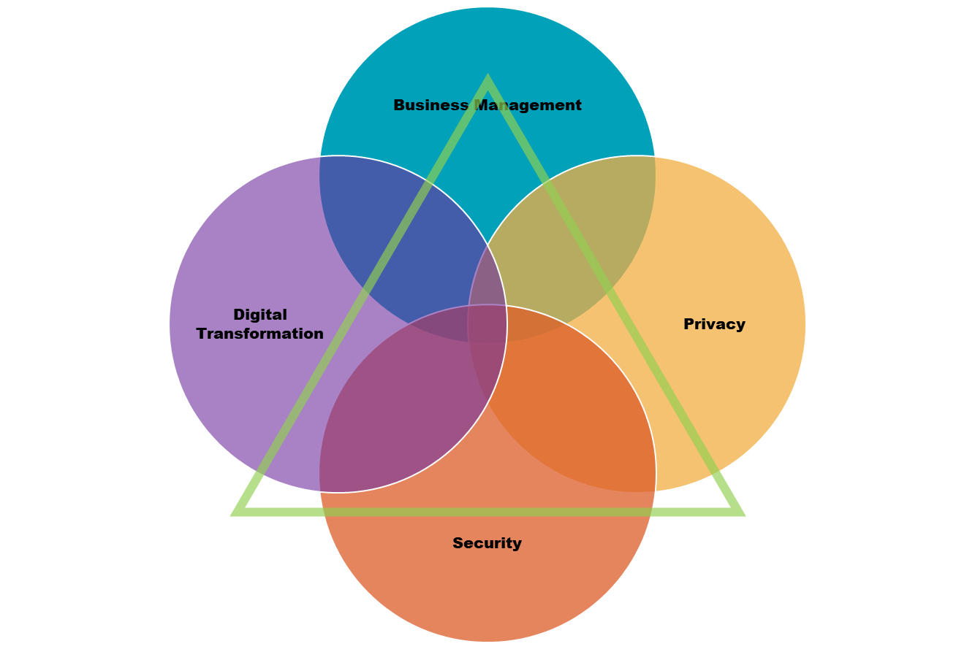
And we could go on..

Slide 37
CIA Perspective
The classic security triad — and where identity lives inside it.
CONFIDENTIALITY
INTEGRITY
AVAILABILITY
Prevents sensitive information from unauthorized access attempts.
Maintains the consistency, accuracy, and trustworthiness of data over its lifecycle.
Information stays consistently and readily accessible for authorized parties.
Implemented with encryption, access control, and more.
Implemented with access control, access monitoring, and data-input controls.
Implemented with infrastructure resilience, redundancy, and monitoring.

Slide 38
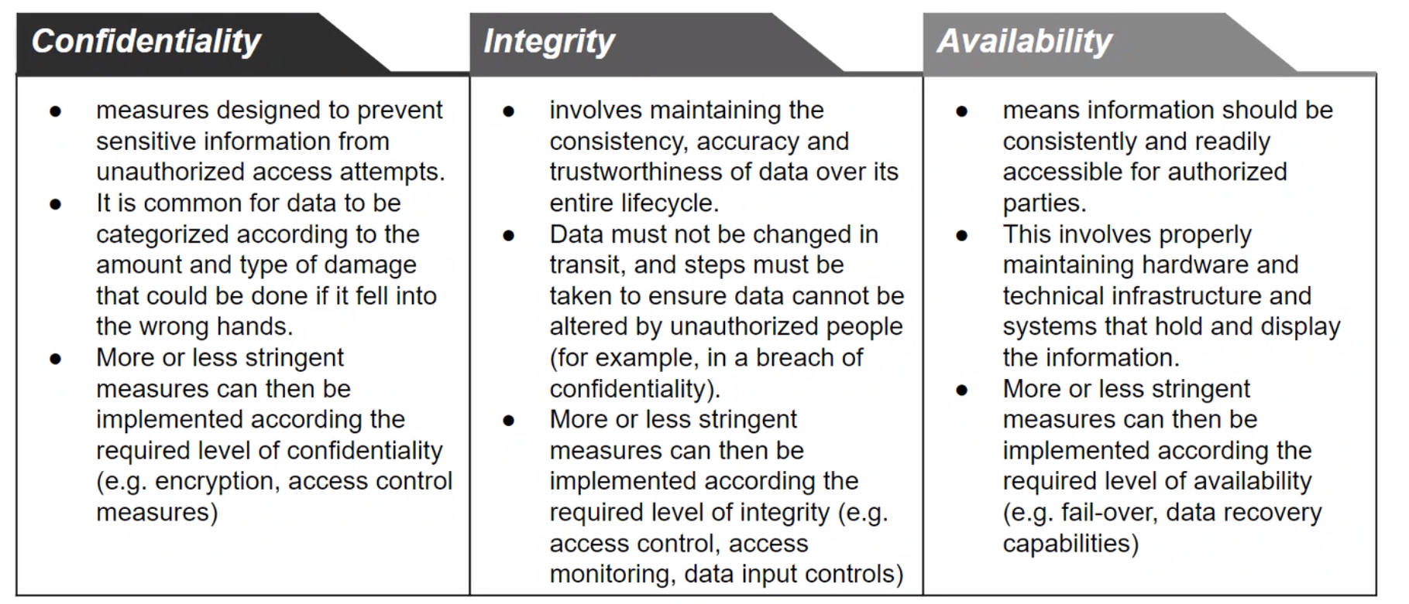
CIA Perspective
The classic security triad — and where identity lives inside it.

Slide 39
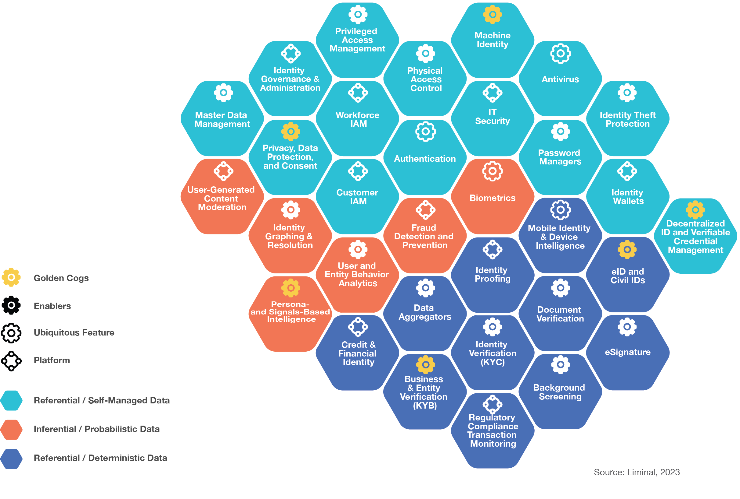
Market or Investor Perspective (2023)

Slide 40
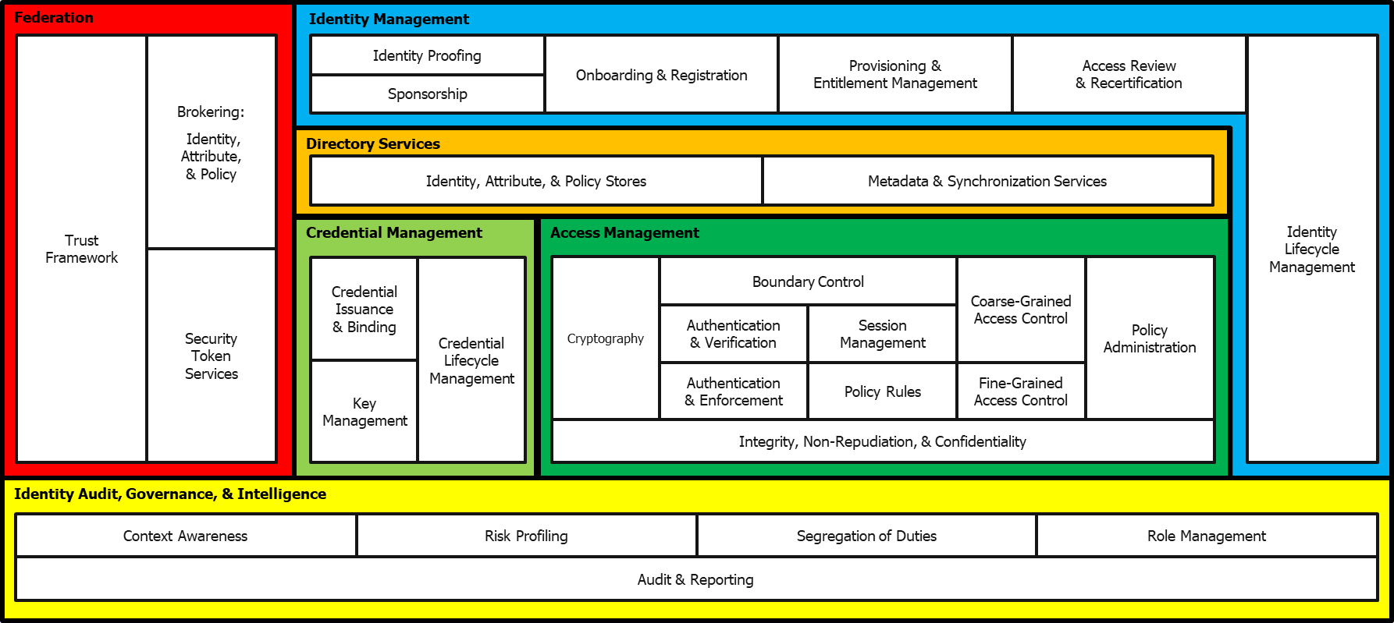
Architecture Perspective
An IAM reference architecture, color-coded by capability domain.
Source: Steve Hutchison, Daniel Hedrick

Slide 41
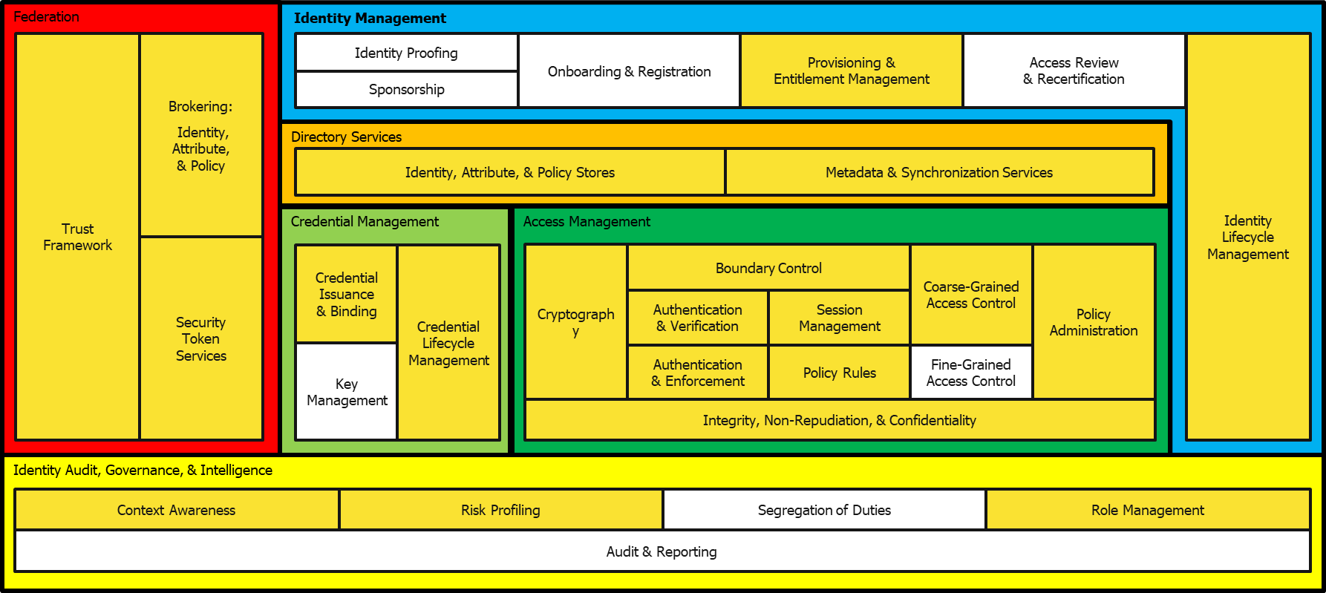
Process Perspective: User Accesses a SaaS App
The same architecture — with the zones involved in this specific flow highlighted.
Source: Steve Hutchison, Daniel Hedrick

Slide 42
Process Perspective
The same flow, simplified — the four moments that matter.
01
Validation
02
Authentication
03
Authorization
04
ACCESS
The decisive moment — in orange — is where everything before either pays off or fails.

Slide 43
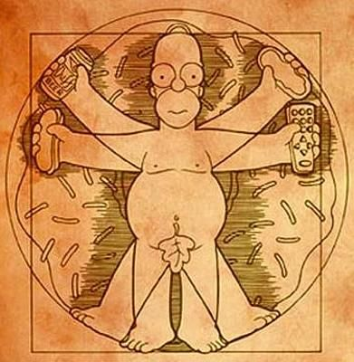
What if there’s a robot, machine or some other inhuman thing in between here?
Passwords here (until they aren’t..)
ABAC, Access Control ++
For AuthZ we often need to do more lookups for additional data from the swarm
Consent
Delegation
«on behalf of»
KYC
Manual or
automatic
fact checking
Validation
AutheNtication
AuthoriZation
«I have permission»
Results in a swarm of registered data
Make «accounts»
Make «tokens»
(for logged in sessions)
Can be used to reference/find attributes to check
But wait, there’s more! We also need: Usage data (monitoring, detection, re-checking), stronger mechanisms for high risk accesses, UX++
Notes:
The full picture (with all the moving parts)

Slide 44
But where does the magic happen?
THE FRAME
KEY POINT
The overall architecture and supporting processes leverage various functions and mechanisms to deliver good-enough protection.
Apart from the initial setup, the functions execute at different places in the process.
→ Which is the next section: Admin-time vs Run-time

Slide 45
Questions to ask: Perspectives
04 / 10 · PERSPECTIVES
Deepen your understanding
Challenge assumptions
Which perspective dominates your IAM conversations — security, privacy, business enablement, or architecture? Which one is missing from the table?
When your IAM team talks to the business, do they speak the business’s language — or do they expect the business to learn IAM’s?

Slide 46
Governance
04
SECTION 04
The unglamorous work where most identity programs live and die.
#identiverse | 46

Slide 47
Sources of Truth
Where does identity data come from — and how much do you trust each source?
Workforce (B2E)
Partners (B2B)
Customers & Citizens
Usually a single HR system of record.
Partner HR, delegated admin, or a federation service.
Self-registration, social logins, government registries.
Truth isn’t singular. It’s distributed — with different authority depending on context.

Slide 48
Provisioning & Lifecycle
Joiner, Mover, Leaver — and what gets left behind
What it does
Where it usually breaks
Creates, updates, and removes accounts in your managed systems.
Driven by events from sources of truth — hire, transfer, termination.
Assigns and revokes entitlements as people join, move, or leave.
Standard worth knowing: SCIM.
Joiners get access on time. Leavers — not always. Movers almost never.
Stale entitlements accumulate; people keep access from old roles.
The “Mover” problem is the #1 source of accumulated risk in workforce IAM.

Slide 49
Entitlement Management
Cataloging what people can actually do — and why most organizations can’t
The ideal
The reality
Every entitlement has a meaningful name.
A description anyone can understand.
A named owner accountable for it.
Mapped to job responsibilities and user types.
GRP_FIN_LEGACY_03 — no description, no owner, nobody remembers what it does.
Hundreds or thousands, accumulated over years.
Mappings to job roles exist in someone’s head, if at all.
And yet — this is the foundation everything else depends on.

Slide 50
Role Management
An abstraction layer between people and permissions.
Business role
“Purchasing Clerk”
what HR and managers understand
Technical roles
ERP_PURCHASE_USER, INVENTORY_READ, SUPPLIER_LOOKUP
what the apps grant
Individual permissions
create_po, view_supplier, read_inventory
what actually executes
Roles make the unmanageable manageable — but who keeps the mapping current?

Slide 51
Access Certification
Periodic review of who can access what — and why it rarely works
What it’s supposed to be
What it usually is
A manager reviews each person’s access on a regular schedule.
Inappropriate or stale access is identified and removed.
Risk is reduced over time as permissions are pruned.
200 entitlements to review per quarter, with no context.
The manager rubber-stamps everything to make the deadline.
Audit evidence is produced. Risk is unchanged.
The fix: give certifiers the data to make real decisions + let them focus on only the important ones.

Slide 52
Privileged Access — what is it, really?
PAM is, in many ways, a mini mirror-universe of Identity and Access
What “privileged” usually means
What it should also include
Sysadmins, root accounts, infrastructure access.
Service accounts that run as administrators.
Anyone with the keys to the OS or database beneath your apps.
Application owners who can change access rules in their own apps.
Anyone who can modify identity data, policies, or roles.
Anyone whose mistake or compromise has outsized impact.
Your business must decide what counts as privileged.

Slide 53
Questions to ask: Governance
05 / 10 · GOVERNANCE
Deepen your understanding
Challenge assumptions
How much of your entitlement catalog has meaningful descriptions and named owners — not GRP_FIN_LEGACY_03 with nobody attached to it?
When a manager certifies someone’s access, do they have the information to make a real decision — or are they rubber-stamping because that’s the only option you’ve given them?

Slide 54
Questions to ask: Privileged Access
06 / 10 · PRIVILEGED ACCESS
Deepen your understanding
Challenge assumptions
How does your organization define what’s “privileged” — is it formally documented, or is it whatever your security team decided last quarter?
Does “privileged” include the application owner who can change access rules in their own app — or just the sysadmin who runs the OS underneath it?

Slide 55
Admin-time vs Run-time
05
SECTION 05
Two clocks. Most identity confusion lives between them.
#identiverse | 55

Slide 56
Two different moments in time
Get this distinction right and everything else falls into place.
ADMIN-TIME
RUN-TIME
Before anyone shows up at the door
Cataloguing entitlements
Classifying what’s sensitive
Setting up governance and policies
Managing identity lifecycle
Huge potential for automation
Can run continuously in the background
The moment someone knocks
Authentication
Authorization
Session management
Token issuance and validation
Decisions happen in milliseconds
No time to ask humans

Slide 57
Some things blur the line
Three categories that span both admin-time and run-time.
Identity Proofing / Validation
Analytics
Privileged Access
Often a one-time admin-time event — but re-triggered at run-time for high-risk transactions.
Static analysis at admin-time (role mining, peer comparisons) vs event-based detection at run-time.
Defined and configured at admin-time; granted just-in-time at run-time.

Slide 58
Questions to ask: Admin-time vs Run-time
07 / 10 · ADMIN-TIME VS RUN-TIME
Deepen your understanding
Challenge assumptions
Look at your IAM decisions: which happen admin-time, which happen run-time? Is the balance deliberate or accidental?
When a policy changes, how long before every enforcement point is using the new version? Do you actually know — or are you assuming?

Slide 59
Authentication
06
SECTION 06
“Prove you are who you say you are.”
#identiverse | 59

Slide 60
Authentication: claim and prove
The same pattern — whether it’s a person, an agent, or a service.
THE CLAIM
THE PROOF
“I am Espen.”
An identifier — anyone can present one.
Identifiers alone prove nothing.
“And here’s how you can verify that.”
Credentials, factors, possession of a key.
The proof binds the claim to a verifiable property.
Authentication takes an identifier as input and produces confirmation that the entity really is what it claims.

Slide 61
Identifiers are not factors
Email plus password is one factor, not two.
Email
espen@example.com
IDENTIFIER
Password
••••••••••
FACTOR — something you know
or
Continue with Google
IDENTIFIER
Continue with Facebook
Factors are additional proof — not multiple identifiers.

Slide 62
How authentication is evolving
MFA → Adaptive
Passwords → Passkeys
Trust under pressure
Static MFA was the floor. Adaptive auth adjusts based on risk, context, and behavior.
FIDO-based passkeys are passwordless, phishing-resistant, and now broadly supported — worth a dedicated session this week.
Deepfakes, voice cloning, AI-generated phishing — the trust mechanisms here are being tested as never before.

Slide 63
Questions to ask: Authentication
08 / 10 · AUTHENTICATION
Deepen your understanding
Challenge assumptions
Look at your MFA setup: are the factors actually independent — or are “something you have” and “something you are” both stored on the same phone?
If an attacker had a convincing deepfake of your CEO’s voice and called your helpdesk, which of your authentication or recovery processes would still hold up?

Slide 64
Authorization
07
SECTION 07
“Now that I know you — where can you go?”
#identiverse | 64

Slide 65
Authorization: inside the building
Different badges, different access.
TIER 1
General admission
Public galleries, gift shop, café
TIER 2
After-hours access
adds: private events, research library
TIER 3
Conservation lab access
adds: behind-the-scenes, sensitive collections, the actual artworks
Coarse-grained (which areas you can enter) and fine-grained (what you can do once inside) — both are authorization.

Slide 66
How an authorization decision happens
The pattern behind RBAC, ABAC, PBAC — and every modern authorization framework.
PEP
Policy Enforcement
PDP
Policy Decision
PAP
Policy Administration
request
the door — grants or denies
where policies are written
PIPs
Policy Information
attributes feed the decision
Vendors will show you complex diagrams. The core pattern is mostly these four.

Slide 67
Questions to ask: Authorization
09 / 10 · AUTHORIZATION
Deepen your understanding
Challenge assumptions
Where are your authorization decisions made — inline in each application, or through an externalized decision service? How do you keep policies consistent across them?
When a vendor says their product “does RBAC” or “does ABAC” — do you know whether they built externalized authorization, or just hardcoded some role checks?

Slide 68
AI & Identity
08
SECTION 08
A new class of subject — agents that act on our behalf.
#identiverse | 68

Slide 69
AI is an identity problem
Not a rip-and-replace. An extension of what you already know.
A new subject
A new tool
A new threat
Agents request access. They need identities, credentials, and authorization — like every other actor in your environment.
Agents help make identity decisions: spotting anomalies, suggesting roles, drafting access reviews.
Agents impersonate. Deepfakes, voice cloning, AI-generated phishing — the trust mechanisms you just learned about are under pressure.

Slide 70
Agents need sponsors
Remember “ghost accounts” from earlier? Now imagine them deciding things.
THE PROBLEM
THE EMERGING ANSWER
AI agents proliferate fast — estimates suggest 50 per human user in some organizations.
Many were spun up by developers, never registered, with no named owner.
We’ve seen this movie before — the ghost account problem at machine speed.
Every agent gets a human sponsor — a named, accountable owner.
Ownership is assigned at creation, not after the fact.
When the sponsor leaves, ownership transfers — like any inherited responsibility.
Without this, you can’t answer the accountability question.

Slide 71
Familiar lifecycle, new entity
Everything you just learned about identity lifecycle applies to agents — with a few twists.
HUMAN LIFECYCLE
AGENT LIFECYCLE
you just learned this
JOINER — onboarded by HR.
MOVER — role change, scope change.
LEAVER — offboarded, access removed.
Built on identity proofing, authentication setup, access provisioning.
same pattern
REGISTERED — created by a developer, registered with a sponsor.
UPDATED — capability change, scope change.
RETIRED — decommissioned, credentials revoked.
Same governance questions. Different tools, different speed.

Slide 72
The same hard problems, amplified
What was hard with humans is harder with agents.
The data gap, amplified
The relational gap, amplified
Speed and scale
If we can’t catalog what people are supposed to do, how do we define what an agent is allowed to do on their behalf?
Every action used to assume one actor. Now actions chain through agents, on behalf of users, across systems — the chain has to be verifiable, not assumed.
Agents decide in milliseconds, at 50× human volume. Manual oversight isn’t an option — your policies must be ready.

Slide 73
Questions to ask: AI & Identity
10 / 10 · AI & IDENTITY
Deepen your understanding
Challenge assumptions
When an AI agent takes action on behalf of a user, what’s recorded in the audit log — the agent, the user, both, or just “system”?
How many AI agents are running in your organization right now? Who owns each one, and what happens when those owners leave?

Slide 74
Educational resources
All cited in the deck — take these with you.
IDPro
FIDO Alliance
InCommon
NIST 800-63-4
idpro.org/educational-resources
fidoalliance.org/fido2
incommon.org/academy/iamonline
pages.nist.gov — Digital Identity Guidelines
IDSA
MITRE ATT&CK
idsalliance.org — Identity Defined Security Alliance
attack.mitre.org

Slide 75
Pirate and reuse our slide deck
identi.beer/intro
All slides. All sources cited. Reuse encouraged.

Slide 76
Thank you.
Find us in the hallways this week.
#identiverse · 2026
#identiverse | 76

