Slide 1
Introduction to Identity
Identiverse 2025 • Masterclass

Slide 2
Lance
Espen
Peterman
Bago
Engineering Manager - IAM
Head of IAM
Dick's Sporting Goods
Gritera Security

Slide 3
Pirate and reuse our slide deck: identi.beer/intro

Slide 4
Questions to ask about Identity & Access
Notes:
And some answers – but with no fixed and final truth that’s valid for all, the ability to ask relevant questions (and that requires knowledge and practice) – is the most central skill you should aim for in IAM

Slide 5
“Why should I care about Identity?”
The first challenge we meet with identity is justifying our jobs and our existence.
And with everything digitized:
those who control identity, control the business
Notes:
Are those people outsiders or insiders? Are they well-intentioned? Are they qualified?

Slide 6
Everyone is doing IAM! They just aren’t using our terms for it. Honestly, who can blame them ...
Word cloud or similar, of abbreviations
and technical terms from IAM
JWT
FIDO
SSO
SCIM
PBAC
RBAC
ReBAC
MFA
2FA
UMA
OTP
KBA
PAM
PIM
PUM
CIEM
CIAM
PKI
Maybe the abbreviations to the left are
enough to make the point, if not we can
add actual words as well
Access
Access Right
Account
Endpoint
Entitlement
ID
Identifier
Identity
Permission
Privilege
Role
Profile
Token
User
Username
User Object
User Account
Notes:
I say that everyone is doing IAM, because IAM is nothing new and has been the basis of (for example) transactions forever
-> But now everything is going digital.
So when I say everyone is doing IAM, it means often it's done without us knowing about it, and often in ways we don't like
-> Results are silos, ad-hoc procedures and overall lower efficiency and security posture.
<CLICK>
And don’t memorize that word cloud! Some of those are terms simply invented by one vendor or the other..
To have conversation with the people doing all of this IAM
-> We need to get beyond such terms, to the underlying meaning of it all.

Slide 7
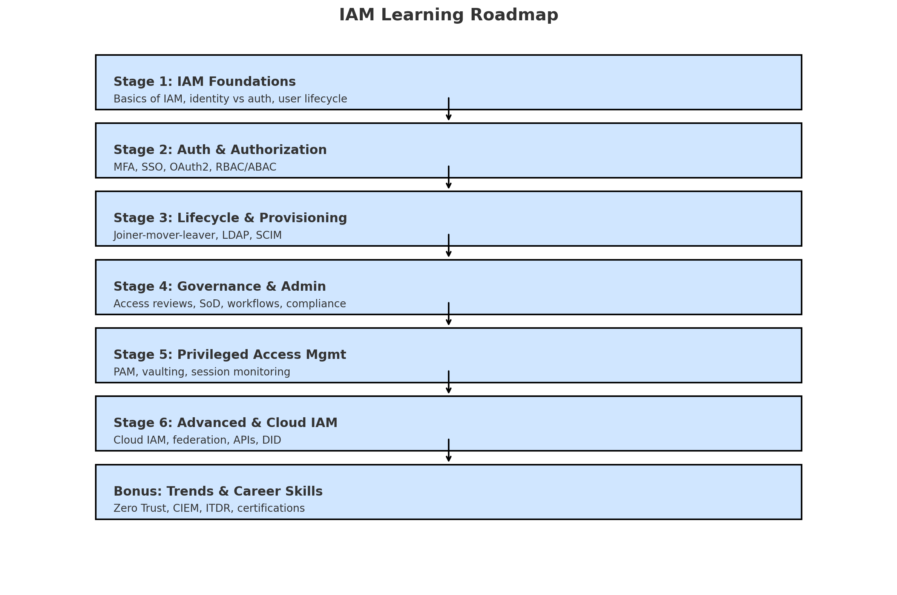
If you ask ChatGPT

Slide 8
What goals are we racing towards?
Notes:
Identity is not a race where the winner is the first to achieve 100% security – absolute protection.
Phrases such as Zero Trust or Least Privilege might make you think that.
Absolutes do not exist.
If it’s a race at all, it’s a race to have the most well-adjusted and balanced Identity and Access mechanisms in place. I would posit that instead of viewing the management of identities much like that of security being a race, instead we should consider it a journey, much like life. We’ll talk about that more in a moment.

Slide 9
Digital Identity
IAM
IAG
IDM/AM/PAM/..
Access / Identity
…………… control
…………… governance
…………… management
..
field
area
industry
discipline
specialty
..
What is this
of
?
Notes:
You're going to hear a lot about identity and access this week - a topic that most of you have probably heard a lot about already.
Now, if you are in this room here today, we assume it's because you'd like to get as much out of this week as possible.
We have the same goal for this session
And while assuming that you've heard a lot about identity, I'm also assuming it didn’t all make sense.
And I am assuming that you don’t always find it easy to take part in conversations about identity.

Slide 10
It’s a lot of things – and not just
IAM
IGA
AM
PAM

Slide 11
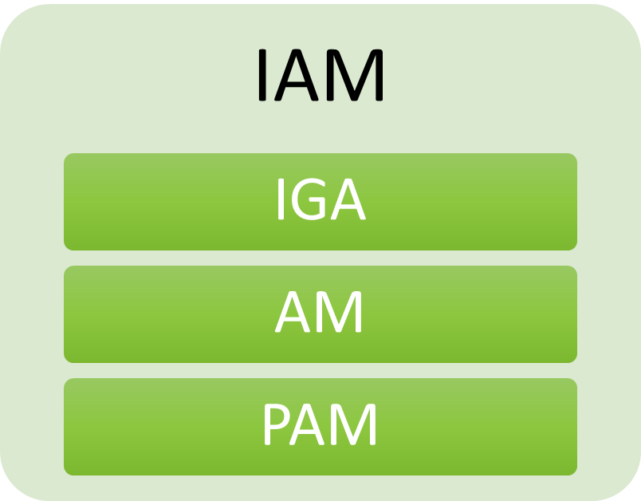
It’s a lot of things – and not just
+++
UBA
ITDR
PKI
AIA
SSI
DID
Trust
KYC
Consent

Slide 12
Definition
“[IAM] helps the right people or machines to access the right assets at the right time for the right reasons, while keeping unauthorized access and fraud at bay.”
(Gartner and others)
Can we cut to the core of this?
IAM provides controlled access to resources.
Our task is to understand what this control can look like
Notes:
This is the definition of IAM you’ll find in the Gartner dictionary.
I think even that is too much sometimes, so I’d like to put it differently:
<CLICK>
IAM provides controlled access to resources.
Where Controlled means: “Under certain conditions”
And the Resources are Limited (because IAM wouldn’t be needed otherwise) & have to be Prioritized (because not everything has the same importance)
<CLICK>
Let’s deconstruct based on this.
<CLICK>

Slide 13
Why
Outcomes and goals
IAM toolbox
Access & protection
Users
Resources
Who
What
Notes:
This diagram shows what you need to understand and map – and in the middle are the tools to make it happen.
IAM exists to provide controlled access to (selected and limited) resources.
There is always WHY of Identity, which starts with understanding WHAT types of resources you're asked to protect or provide access to — and the purpose for doing so.
And we need to understand WHO owns them and WHO otherwise are responsible and accountable for them and in general WHO cares about them.
<CLICK>
Then we can come along, carrying our toolbox.

Slide 14
Outcomes
Why
Nontechnical description of: «What change needs to be delivered?»
Enable business
Higher productivity
Better user experience
Fewer calls to the help desk
Enhance security and risk
Better informed access decisions
Better protection
Enhancing security and risk management
Enabling digital business
Trust
Agility and robustness
Confidentiality, integrity and availability
Customer satisfaction
Privacy, safety and reliability
Employee engagement
Resilience
Shifting investments
Notes:
For Identity, the WHY should correspond to what changes and effects we are expected to deliver.
We should learn to identify “Overall outcomes” – of which these are general examples.
Start with finding out what Identity is meant to achieve and work backwards from this.
(Try to focus on one use case or one user journey at a time and then identify which of the tools in our toolbox are most useful.)

Slide 15
Stakeholders
Who
Identity professionals
Developers
PMs
Auditors
Product owners
Architects
Executives
…
Business
Consumers
Workers
Contractors
Citizens
Partners
Services
Devices
...
Who is IAM for?
serving
Notes:
There are many stakeholders in IAM, which is easy to underestimate.
Continuous stakeholder analysis – and seeing the world through their eyes – is one of the most important activities in IAM.

Slide 16
Enter The Value to be protected
What
An object
Notes:
What is a value? What is valuable?
Who are we protecting it for?
And from whom are we protecting it?

Slide 17
Resources: Objects of value worth protecting
What
Objects made available to someone
Objects managed by someone
Objects managed for someone
Objects owned by someone
Information
Money
Tools
Resources
Anything that’s limited
Anything subject to a financial transaction
Notes:
The WHAT of Identity are the resources you're asked to provide access to.
You should practice identifying all the different types of resources relevant to your situation. Don't expect your stakeholders to tell you which IAM functions to use
-> and if they do, be wary,
But do ask them to specify which resources are the most important and at what priority.

Slide 18
Objects vs Subjects
Shiny Thing

Slide 19
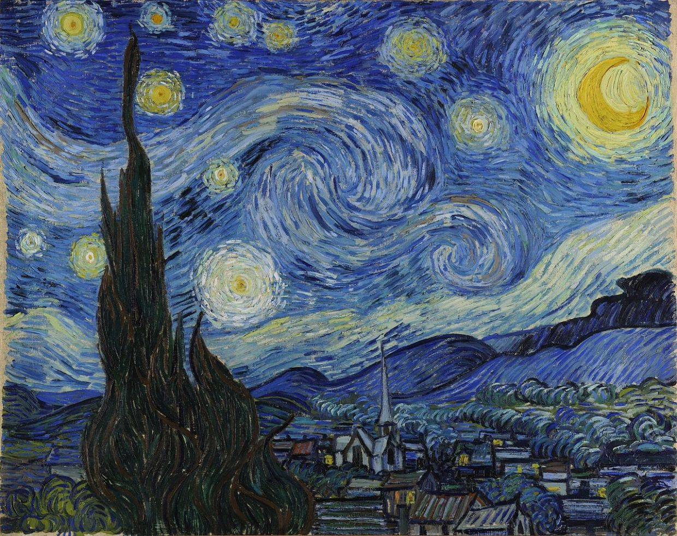
Objects, Subjects and Rules
?
I’m going to touch it!

Slide 20
Objects, Subjects and Rules
No, you’re not..

Slide 21
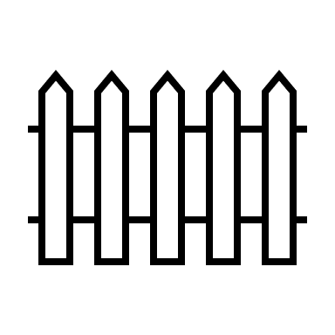
Objects, Subjects, Rules and Barriers

Slide 22
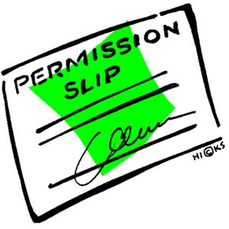
?
Actually, I have permission!
Figures reused from xkcd.com with permission
Notes:
Who issued that permission?
«Mom said it was OK..»

Slide 23
Bearer Token
{
"iss": "http://idp.example.com",
"sub": "248289761001",
"aud": "http://sp.example.com",
"jti": "_d71a3a8e9fcc45c9e9d248ef7049",
"nonce": "n-0S6_WzA2Mj",
"exp": 1311281970,
"iat": 1311280970,
"nbf": 1311280970,
"acr": "phrh",
"amr": "face",
"uid": “NAV_ident_ebago"
}

Slide 24
How about a real-world example?
Notes:
I think this marks my first real invocation of running as a metaphor for identity, but bear with me. In this scenario, when I run at parkrun, at the finish, I get one of these tokens. This is a fun bridge of the digital and analog worlds. I present my newly gained (temporary) finish token, and…

Slide 25
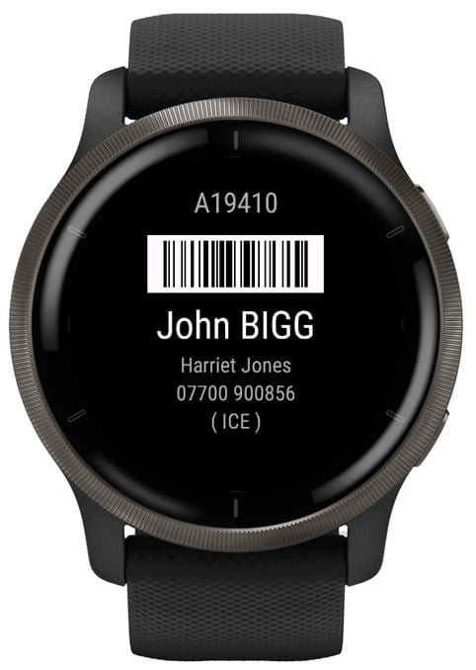
Notes:
Combine it with my digital identity presented here on my watch. The scanner scans both items to correlate my time for the run and a resource is gained in the form of an official time for my parkrun at that location on that day. The elegance and simplicity of this cannot be understated. But this is a real-world basis for one aspect of identity we haven’t spoken of yet: context

Slide 26
Identity Contexts

Slide 27
Me as an Example
Employee
One place of employment, but many data sources.
For each context there is a different set of data to collect, and different ways to collect it.
Consumer
More data that you can count ...
Citizen
Data about me as a potential patient.
Data about me as a voter.
Data about me as a taxpayer.
Volunteer
Blood donor data.
Organizer of IdentiBeer Meetups.
Notes:
Understanding IAM is also about understanding different contexts of Identity.
Using myself as an example, identity relevant data about me is collected and curated in many different places - and someone building an IAM system in one of those places will likely aim to collect even more.
These data sets are relevant for different aspects of my person — different personas, so to say — and to different stakeholders.
Do I have a different Digital Identity for each different data set about myself?
That might very well be!
Will these interact and conflict? That’s a relevant and interesting question to examine..

Slide 28
Example: ME!
Employee x 3 (DSG, UNCC, Meck BOE)
Customer x2
Professor
Alumnus
Precinct Official
Voter
Consumer
Citizen
Taxpayer
Patient
Notes:
Let’s set the context in practical terms first, then we’ll give the broader theme. This is a great way of introducing identity & me in the same slide (no pun intended!). I am an employee or agent of 3 organizations:
Dick’s Sporting Goods, the University of North Carolina at Charlotte, and Mecklenburg County’s Board of Elections.
Now, even within those basic employee roles comes complexity, sidenote, this is why a systems view of identity can be so valuable. That’s a talk for another time. (note to self for CFP next year)
As a DSG employee, I am also a customer. I’m also a customer at UNCC, for example in their various vendors on campus. I’m also a former student there, with both student data and alumni information which I get reminded of every year when they ask me for money.
As a precinct official, I’m also a voter. I’m obviously also a consumer, giving the good city of Los Vegas some of my money this week.
I’m also a Citizen, with another context of taxpayer, and also a volunteer with the city…you get the idea…context results in even more complexity.
Finally, I think it is critical to mention the Patient context. We get daily reminders of how critical our data is, especially when it lands in the wrong hands.
So let’s take that context up a level which gives us a lens, if you will, in how to view the perspectives I’ll be sharing momentarily:

Slide 29
The Identity Hierarchy
Person
Physical
Identity
Systems
Digital
Access rights
Accountable (or responsible)
Holds governance data
Has identifier and maybe credentials
Often system-specific
Notes:
It’s already causing trouble for many Identity products.
The reason is that we call so many different things «an Identity».
<CLICK>
But you’re always going to need someone to be accountable – and Identities can rarely be held accountable for anything, you need people for that.
<CLICK>
And we shouldn’t confuse Identities with things like Accounts and Access Rights, because those typically can’t hold governance data.
<CLICK>
So while your work – and many Identity tools – might revolve around the green inner rectangle, remember to make the connection all the way up to someone real.
—
Reference: Digital identity refers to a set of electronically captured and stored attributes and/or credentials that can be used to prove a feature, quality, characteristic, or assertion about a user, and, when required, support the unique identification of that user.
A natural person or a legal person, or a natural person representing a natural or legal person, is often referred to as a User.
(OECD Recommendation of the Council on the Governance of Digital Identity)

Slide 30
Identity Contexts
Workforce Identity
Customer Identity
Consumer Identity
Citizen Identity
Are we missing any buckets here?
Notes:
Remember, this is big picture so the buckets are bigger. The first big bucket and most conventional subject on identity is workforce. Conventionally we used to refer to it as employee identity but that was too limiting. The next big bucket is Customer Identity. Consumer Identity, what’s the difference, not to be redundant, but context. A consumer isn’t necessarily buying something. A customer usually is. Finally, Citizen Identity. Again, think big buckets.
Better art goes here

Slide 31
Persons + all the Other Users
Taxonomy
User constituencies
Stored entities and associated logs, policies and metadata
IAM
Human
Nonhuman
B2B
B2C
Machines
Organizations
B2E
Vendors/ consultants/partners
Animals
Employees
Customers
Devices
Workloads
Other
Accounts
Accounts
Accounts
Desktop
VMs
Mobile
Containers
Services (web, REST APIs, RPC, webhooks)
IoT/OT
Source: Gartner, Erik Wahlström
Applications (apps [web, mobile, desktop, hybrid], scripts services/ service accounts, RPAs, AI apps [agents and assistants])
Notes:
For another perspective on WHO we are in IAM:
- > here’s an example taxonomy of things in IAM, inspired by taxonomies of natural sciences, created by Erik Wahlstrøm of Gartner.
I just want to make the point that you need to divide up your world to understand it – and dividing it up might help you see it differently.
Before we go on – notice the “Human” versus “Nonhuman” distinction chosen here. This is going to cause you trouble..

Slide 32
Anybody Recognise This?
Notes:
A great metaphor for understanding identity is the classic kaleidoscope. Convenient that there are 4 lenses here, no? Each rotation allows us a different…work with me here?

Slide 33
Perspectives for Identity
Notes:
Adding perspective to the established contexts of the subjects and objects in an identity relationship helps establish the WHY

Slide 34
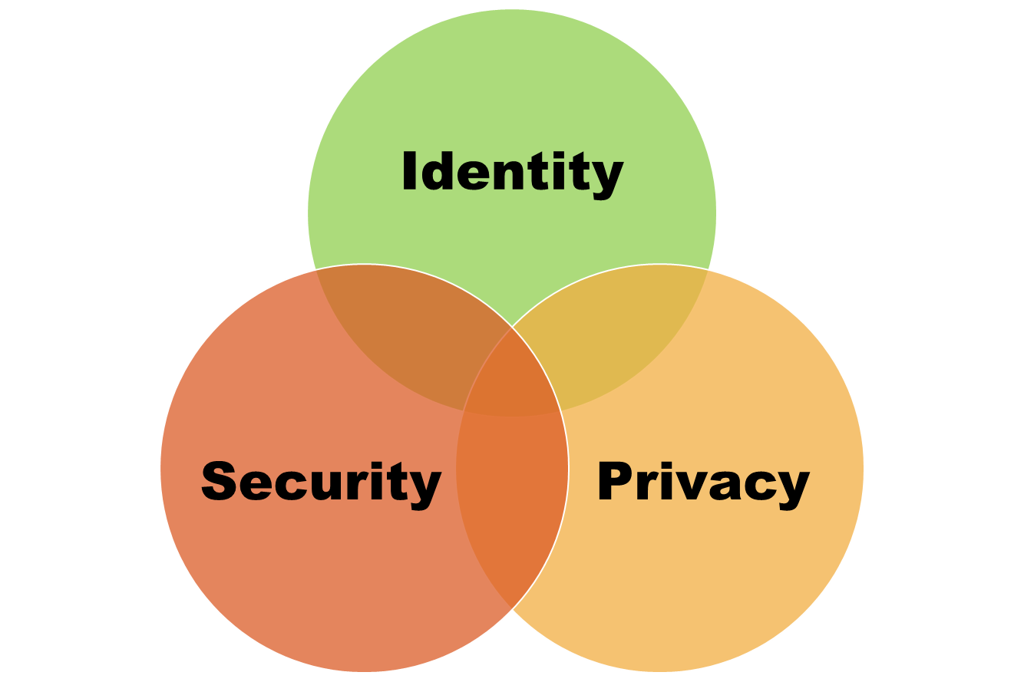
Notes:
This is the three legged stool of Information Security.

Slide 35
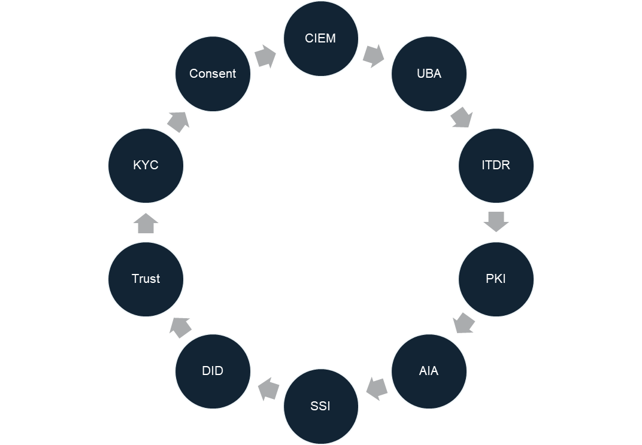
Notes:
This is an incomplete acronym salad for Digital Identity.

Slide 36
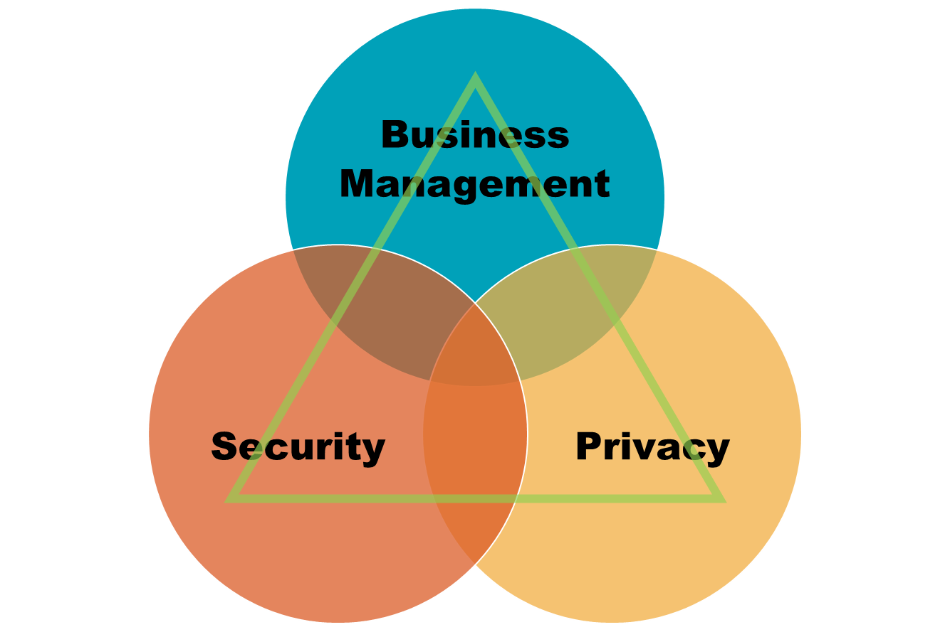
Notes:
One of the things that differentiates Identity from the other two legs of the stool is its criticality in supporting business functions. Yes, identity is central to achiving security and privacy objects, but it is also fundamental to its operation.

Slide 37
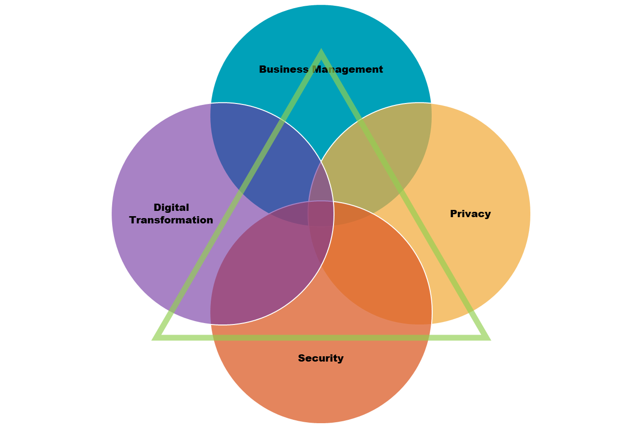
Notes:
Once companies embarked on their path to Digital Transformation, this is particularly where Customer Identity programs began to see explosive demand. This is the first example I use for my students: for every website you visit, do to anything beyond browse (and sometimes even for that), what do you have to do first? <call and response here, hopefully>
Exactly, LOGIN. A user’s experience literally begins with their identity experience. So part of the why is established, but let’s add some additional perspectives.

Slide 38
CIA Perspective
Notes:
The CIA triad is the bedrock of information security. Not surprisingly, identity lives at its core.

Slide 39
Investor or Market Perspective
Notes:
This can look a little scary, but it is simply meant to again provide a perspective in how potential investors look at the identity market. It has been amazing to see how this has evolved over the years.

Slide 40
Architecture Perspective
Source: Steve Hutchison, Daniel Hedrick
Notes:
Much of my career has been spent delivering on this perspective. It can be a little overwhelming, but I think it represents well the litany of services that makeup a highly functioning identity architecture. Now, to be clear, this particular refrerence architecture applies mainly to workforce identity. When you twist that kaleidoscope to flip to customer and consumer contexts, it will look very different. Selfishly, there is a masterclass in the C3i track that will help you see that view.

Slide 41
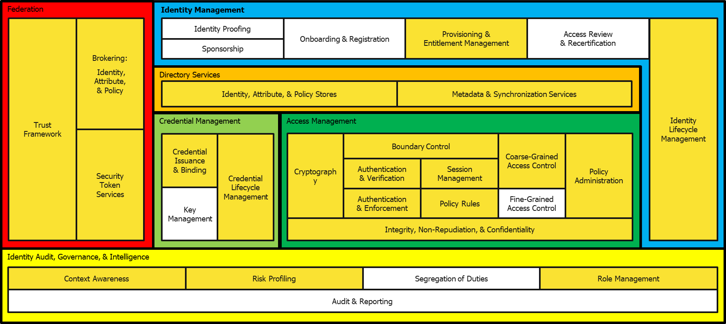
Process Perspective: User Accesses (SaaS) App
Source: Steve Hutchison, Daniel Hedrick

Slide 42
Process Perspective
Validation
Authentication
Authorization
Access!
(Granted or denied)
Notes:
Overall.
But we can go a little deeper:

Slide 43
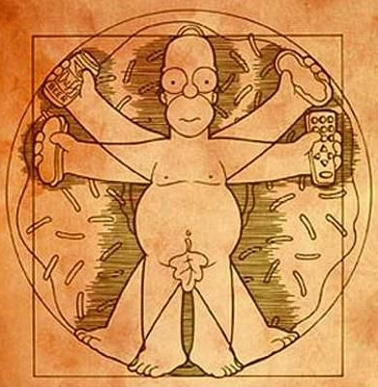
What if there’s a robot, machine or some other inhuman thing in between here?
Passwords here (until they aren’t..)
ABAC, Access Control ++
For AuthZ we often need to do more lookups for additional data from the swarm
Consent
Delegation
«on behalf of»
KYC
Manual or
automatic
fact checking
Validation
AutheNtication
AuthoriZation
«I have permission»
Results in a swarm of registered data
Make «accounts»
Make «tokens»
(for logged in sessions)
Can be used to reference/find attributes to check
But wait, there’s more! We also need: Usage data (monitoring, detection, re-checking), stronger mechanisms for high risk accesses, UX++
Notes:
I’ve been talking here mostly about functions that happen right there and then, because someone attempted to get to a value.
That «fact checking» is the most obvious part that needs to have happened already earlier.

Slide 44
But, where does the magic happen?
The overall architecture & supporting processes are leveraging various functions and mechanisms to deliver good enough protection.
Key Point: Apart from the initial setup, the functions are executing at different places in the process.

Slide 45
Governance

Slide 46
Governance of Identity
Workforce, Contractors, Partners/Businesses, Customers..
Sources of Truth
Identity Repository, Account Directory, etc
Entitlement Management
Access request, approval and re-approval
Roles
Policies
Audit and reporting
Lifecycles of all of the above

Slide 47
Sources of «Truth»
An authoritative place to go where you can learn about a person
B2E: HR
B2B: the partner's HR, a delegated admin, their federation service
B2C: the individual, their social persona, a government (G2C)
B2B2C
Notes:
May have multiple / may require multiple
Assume data quality is not awesome

Slide 48
User Provisioning & Lifecycle Management
Creates, Maintains, and Removes objects such as user accounts in managed systems
Automatable by events from sources of truth: Join / Move / Leave
Can assign or remove permissions, entitlements such as group membership, roles, and profiles for authorization purposes

Slide 49
User Provisioning: Continued
Can have approval processes associated with creation and changes to user accounts
Relies on connectivity to managed systems
That doesn't have to be fully automated... could be a manual process driven via a help desk ticket
Relevant standard: SCIM (System for Cross Domain Identity Management)

Slide 50
Entitlement Management
Applications have permissions such as "create purchase order"
Permissions often get aggregated into entitlements for easier management
Entitlements include groups, technical roles, business roles, profiles, permission sets
Instead of assigning people individual permissions they are often assigned entitlements

Slide 51
Entitlement Mgt: Continued
Entitlement Management involves the cataloging of assignable entitlements
Adding meaningful descriptions
Adding "owners"
Mapping entitlements to job responsibilities or types of users
"Purchasing clerks get these groups"
"Tier 1 Partners get this profile"
Often necessarily pre-work before doing segregation of duties analysis and enforcement

Slide 52
Role Management
Individual entitlements can become hard to manage
They can get aggregated into roles of 2 flavors:
Business roles = job responsibilities
Technical roles = collections of lower-level entitlements to enable access
Roles, especially business roles, can be mapped to HR job codes and positions
As well as partner classifications
Entitlements within a role need on-going review
Assignment rules that map roles to people need on-going review

Slide 53
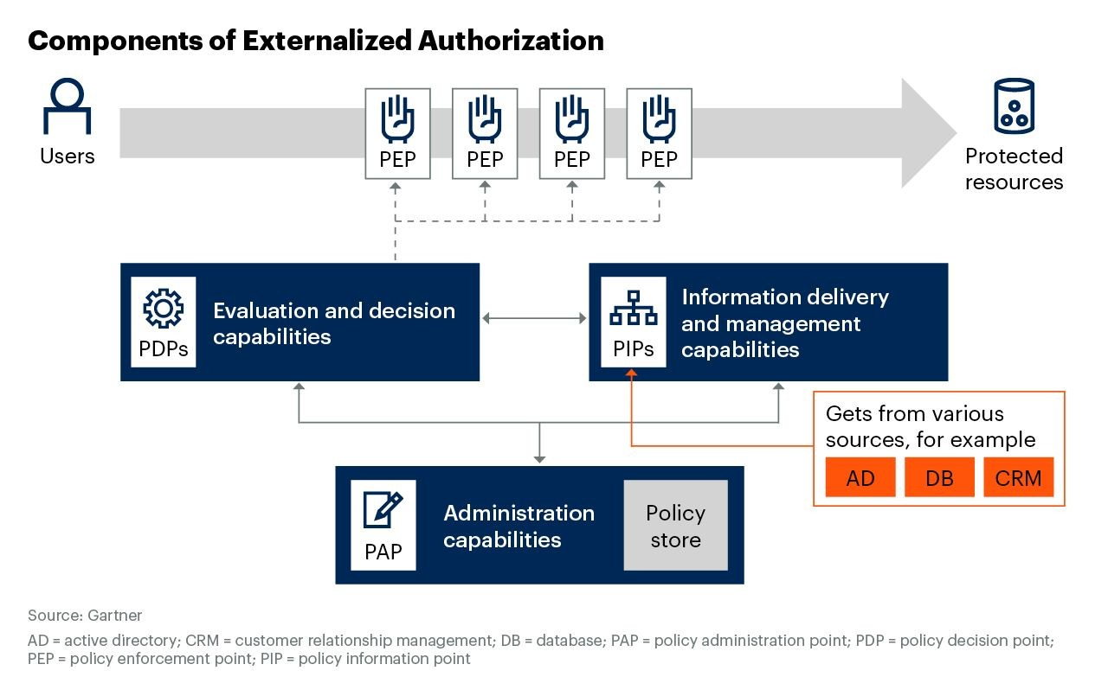
RBAC – ABAC – PBAC + +
“X” Based Access Control
These are all perspectives on the same thing:
The input for making a Decision about Access (granted or denied)
Notes:
Roles as the primary handle for governing access to systems and resources
Might work well in homogenous and hiererachical organizations
Doesn’t work in matrix organizations
"Role explosion" = more roles than people

Slide 54
Access Certification
On-going review of who can access what
Ideally a tool to prevent people from keeping access they no longer need
But it only works if the certifiers have stamina and the right competency for making those decisions
Changes to entitlements can trigger reviews
Changes to job roles can trigger reviews
Risk events can trigger (scoped) reviews

Slide 55
Identity Analytics and Intelligence
Find commonalities and outliers among user populations
Group commonly assigned entitlements together as candidate roles
Identified over-privileged users and other deviations
Discovers undocumented high privileged access (HPA) rights assigned to regular, non-privileged, accounts.
Also a tool for designing better access policies.

Slide 56
Validation / Proofing
Establishes the data and the resulting data set (digital identity)
Do we trust the data? Why? How?
Decentralized Identity
Self Sovereign Identity
Verified Credentials (examples)
mDL
CIDPRO
Notes:
You will often find Validation, Verification and Proofing defined as being part of the «Authentication» process, which we’ll get to in a moment. But we can get around the fact that how we handle the foundational identity data that everything else relies on, has a very strong dependency on Governance!

Slide 57
Privileged Access

Slide 58
Privileged Access
Not a well-defined term
PAM: A = ?
What is more privileged than the rest?
Why?
Your business must decide
(That probably means you must decide)
How good is your CMDB? Or your APM? Or your other catalog of assets? (CMDB: Configuration Management DB, APM: Application Portfolio Management)

Slide 59
Privileged Account Management
Some user accounts are extra special e.g. sysadmin, root, etc
Access to accounts like these and account used for service to service integration need management too even though there isn't a single user associated with them
"Check out" access to root
Record actions users take while in a privileged state
Scramble passwords to protect special accounts

Slide 60
Admin-time vs Run-time

Slide 61
The Process/Timeline Requires Preparation
The Run-time elements of AuthN and AuthZ require support and preparation.
The Admin-time elements have that job:
Cataloguing
Classification
Governance
Lifecycle
Related:
Models for Proofing
Models for Authorization
Definition and identification of Privileged Access

Slide 62
When are they executed
Admin-time
In preparation or support for later functions
Potentially continuous
Huge potential for automation
Run-time
At the moment when someone attempts to access the value

Slide 63
Admin-time (aka Config-time, Design-time)
Cataloguing facts into (Directories, Repositories)
“Sources of Truth”
Classification
To prioritize, we need to know the difference between accesses/values
Governance
Every function we set up should be controlled
Lifecycle
Take the necessary actions both at the start, middle and end

Slide 64
Run-time
Authentication
Including Federation
Authorization

Slide 65
Both?
Some are harder to place
Proofing, Validation? Depends on the context
Analytics
Static typically admin-time
Event-based typically run-time
“PAM” – Handling extra-privileged access
E.g. Secrets Management, Just-in-time elevation++
PAM is in many ways a mini, mirror universe of Identity and Access

Slide 66
Authentication

Slide 67
Authentication
“Give me your identifier and assure me that it represents you”
The authentication function takes identifiers as input and aims produce as output:
Confirmation that supposed users are who they say they are.
(Whereas Authorization gives those users permission to access a resource, a value.)

Slide 68
Authentication
Using the established data to bind to something. Why? How?
Federation
Collaborative / Joint Authentication
Centralized Authentication – SSO
Key to note, right now we’re largely talking human actors (users)

Slide 69
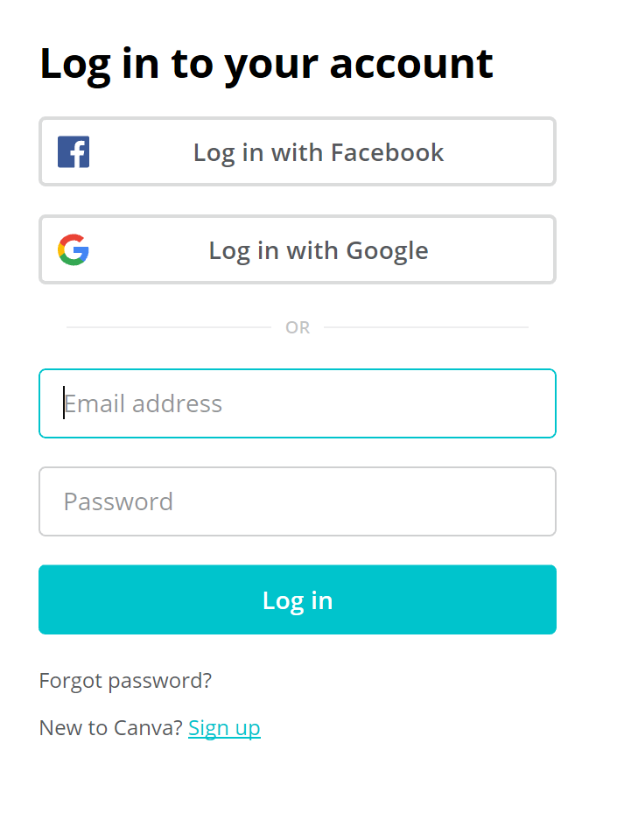
Identifiers
are not factors
Authenticators are factors
So email + password is not 2-factor
Notes:
So username/email adress + password are not 2 factors of input for an authentication function

Slide 70
Authentication: Multi-factor, Adaptive
But how precise are these today?
I don’t know my password..
And the have + are merges in my phone..
Active (challenge) factors:
Knowledge – something (only) you know
Possession – something (only) you have
Inherence – something (only) you are
Passive (context) factors:
Location, time, behavior, patterns
Notes:
Reference BoK++ Nishant, Dean, Khaled

Slide 71
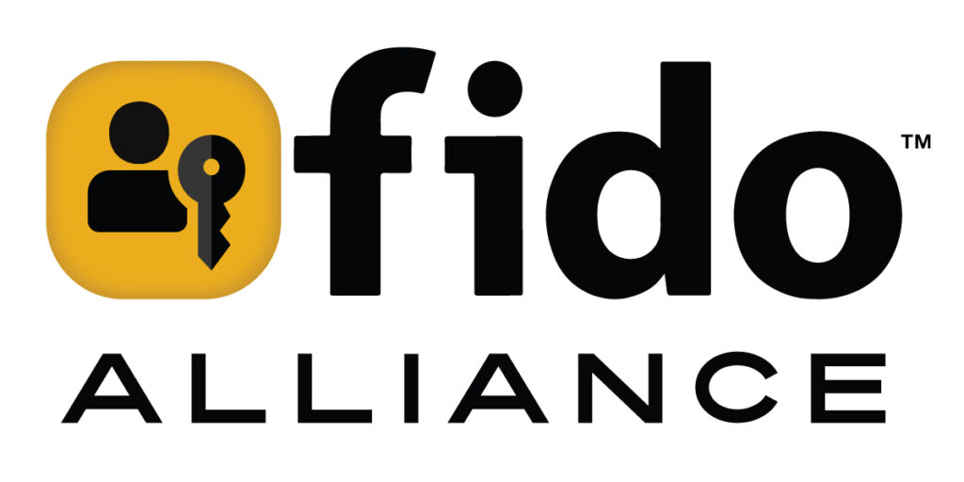
Then what about
Password managers
Passkeys, do you have a minute, or a master class?
By the end of the conference, you’ll know a lot about
Notes:
Reference BoK++ Nishant, Dean, Khaled
Lots of fantastic work by the members of the FIDO Alliance in the genesis of passkeys as probably our best bet to supplement and eventually eliminate passwords.

Slide 72
Authorization

Slide 73
Authorization
OK, you’re authentic and legit – but where can you go?
Access all areas
Principle of least privilege (impossible in practice – why?)
What data do authorization checks require?
How do we implement this?
Authorization decisions
If there is a rule (policy) to follow – is it evaluated by a human or by code?
Good and bad access policies

Slide 74
Authorization models, standards and frameworks
Model: abstract approach to implementing authorization e.g. ACL, RBAC, and ABAC.
Standard: a formally approved set of specifications that define how to address authorization e.g. SAML, XACML, OAuth(!)
Framework: a technical implementation that handles authorization without being a standard itself e.g. Ruby cancancan, OPA, Oso’s Polar, Google’s Zanzibar or AWS’ Cedar.
David Brossard - https://idpro.org/the-state-of-the-union-of-authorization

Slide 75
Additional concepts

Slide 76
Non-Human Identity / Machine IAM
Neither «NHI» nor Machine IAM are new concepts, since such entities have been part of IAM responsibility always.
But the number and variation of “non-standard” identity entities always increase as digitization increases.
And the number of specialized tools for non-standard identities are higher than ever before.
Q:
Is «NHI» a practical and useful concept, or will it confuse stakeholders?

Slide 77
Recovery
Account recovery
Credential recovery
Identity recovery
Biometric recovery
If the cat’s out of the bag.. (Can everything be recovered?)

Slide 78
Assurance
A central concept in Identity and Access
How certain are we
That a thing is what it is presented as
That a thing is the same as the last time we trusted it
That someone we trust (Federation) are doing the right thing
NIST Computer Security Resource Center
Special publication: 800-63-4

Slide 79
Portable Identity
Decentralized
Self-sovereign
Verified Credentials

Slide 80
CIAM
Customer / Consumer / Citizen IAM
Enterprise vs Customer: How does this matter?
Notes:
Ref Mitre, Cody, other attack oriented presentations

Slide 81
CIEM
Cloud Infrastructure Entitlement Management
Cloud vs not-Cloud: How does this matter?
Is Cloud always more complex?
Is on-premise and legacy a «solved problem»?
Notes:
Ref Mitre, Cody, other attack oriented presentations

Slide 82
ITDR
Identity Threat Detection and Response
An interesting combination of functionality – who has it?
Detection is important and Security Operations Centers could be better at understanding “Identity events”
Response includes the capability to recover, for example from Identity/Access centric backups
Compare with SOAR
Notes:
Ref Mitre, Cody, other attack oriented presentations

Slide 83
Attack types (Security purposes)
Account Takeover
Digital means of accessing values are vulnerable
And harder to secure than physical?
Because they are abstract and complex
Notes:
Ref Mitre, Cody, other attack oriented presentations

Slide 84
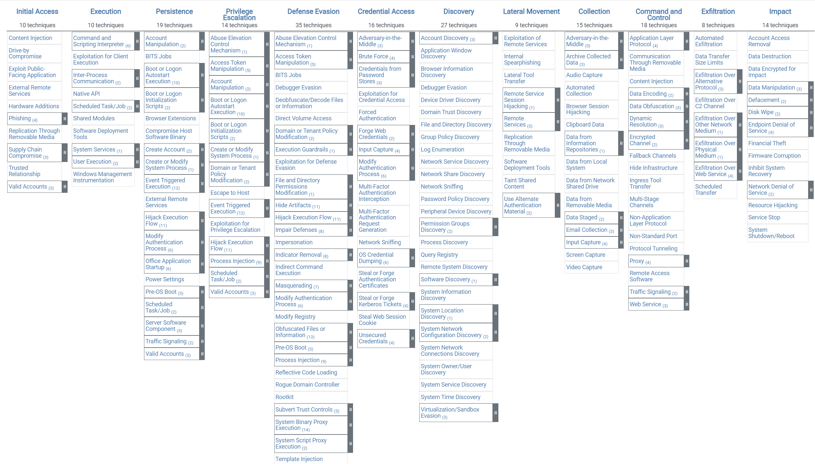
Above are the tactics and techniques representing the MITRE ATT&CK® Matrix for Enterprise. The Matrix contains information for the Windows platform.
https://attack.mitre.org/versions/v15/matrices/enterprise/windows/

Slide 85
Educational resources
idpro.org/educational-resources
fidoalliance.org/fido2
incommon.org/academy/iamonline
pages.nist.gov/800-63-4 (Digital Identity Guidelines)
idsalliance.org (Identity Defined Security Alliance)
attack.mitre.org
a professional association for identity management that exists to globally foster ethics and excellence in the practice and profession of digital identity.
Notes:
If we didn’t already: How many here have heard about IDPro?
Could I ask those that have also joined IDPro as members to stand up?

Slide 86
Pirate and reuse our slide deck: identi.beer/intro

