Slide 1
Introduction to Identity
Perspectives on Access and Identity
Identiverse May 30th 2023

Slide 2


Lance
Espen
Peterman
Bago
Adjunct Professor
Identity Program Owner
University of North Carolina at Charlotte
Norwegian Labour and Welfare Administration

Slide 3

Of what kind is the Identity race?
Notes:
Identity is not a race where the winner is the first to achieve 100% security – absolute protection.
Phrases such as Zero Trust or Least Privilege might make you think that.
Absolutes do not exist.
If it’s a race at all, it’s a race to have the most well-adjusted and balanced Identity and Access mechanisms in place.

Slide 4
Digital Identity
IAM
IAG
IDM/AM/PAM/..
Access / Identity
…………… control
…………… governance
…………… management
..
field
area
industry
discipline
specialty
..
And what is this
of
?
Notes:
You're going to hear a lot about identity and access this week - a topic that most of you have probably heard a lot about already.
Now, if you are in this room here today, we assume it's because you'd like to get as much out of this week as possible.
We have the same goal for this session
And while assuming that you've heard a lot about identity, I'm also assuming it didn’t all make sense.
And I am assuming that you don’t always find it easy to take part in conversations about identity.

Slide 5
A lot of things, not just
IAM
IGA
AM
PAM

Slide 6
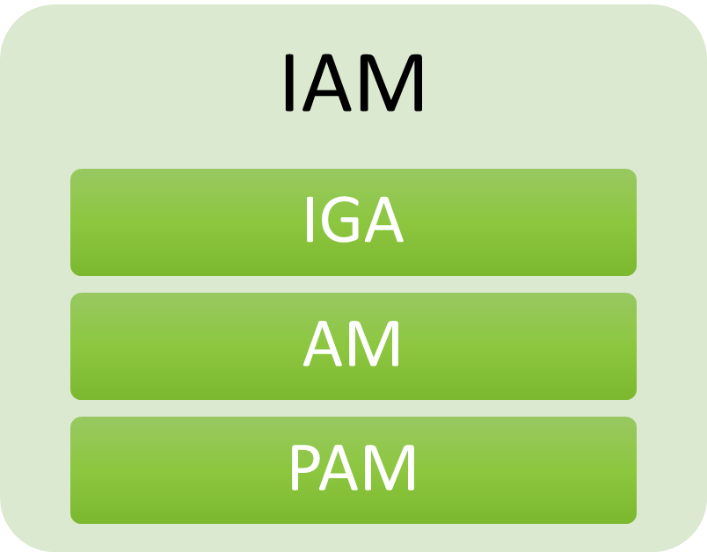
A lot of things, not just
CIEM
UBA
ITDR
PKI
AIA
SSI
DID
Trust
KYC
Consent
Notes:
So many names..

Slide 7
identity professionals
developers
PMs
auditors
product owners
executives
..
consumers
workers
contractors
citizens
partners
friends
services
devices
..
Who is it for?
serving
Notes:
Let’s go back to the basics: Why do we - people like us – exist?
We exist to protect values. But not too much so no one can reach them..
(The last part of the session will be all about the different tools and mechanisms that we have for protecting values, but we should try to remember that there's probably, hopefully always some value there to be protected.)
And what is a value? What is valuable to organizations and people?

Slide 8
Enter The Value to be protected
An object
Notes:
What is a value? What is valuable?
Who are we protecting it for?
And from whom are we protecting it?

Slide 9
Objects of value worth protecting
Stuff I own
Information
Money
Tools
Resources
Anything not limitless
Anything subject to a (financial) transaction
Stuff somebody
manages for me
Stuff I manage for somebody

Slide 10


Objects vs Subjects
Shiny Thing

Slide 11


Objects, Subjects and Rules
?
I’m going to touch it!

Slide 12

Objects, Subjects and Rules
No, you’re not..

Slide 13

Objects, Subjects, Rules and Barriers

Slide 14

?
Actually, I have permission!
Notes:
Who issued that permission?
«Mom said it was OK..»

Slide 15
Bearer Token
{
"iss": "http://idp.example.com",
"sub": "248289761001",
"aud": "http://sp.example.com",
"jti": "_d71a3a8e9fcc45c9e9d248ef7049",
"nonce": "n-0S6_WzA2Mj",
"exp": 1311281970,
"iat": 1311280970,
"nbf": 1311280970,
"acr": "phrh",
"amr": "face",
"uid": “NAV_ident_ebago"
}

Slide 16
Stick figures reprinted with permission from xkcd.com

Slide 17
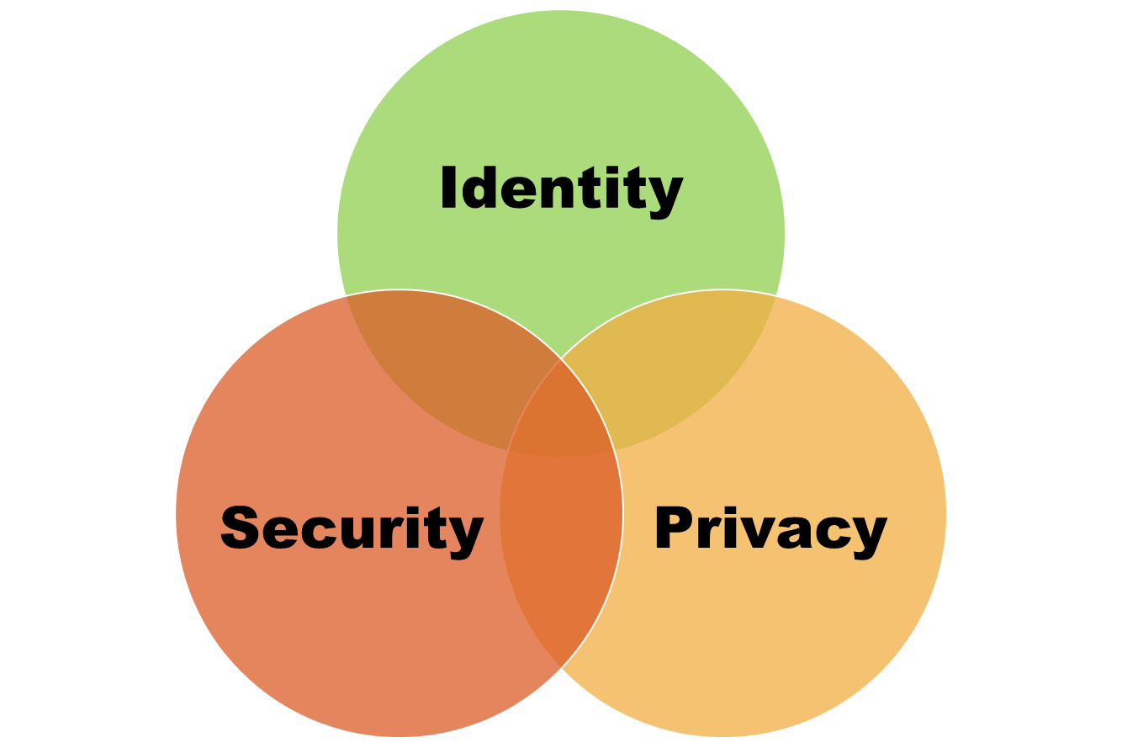

Slide 18
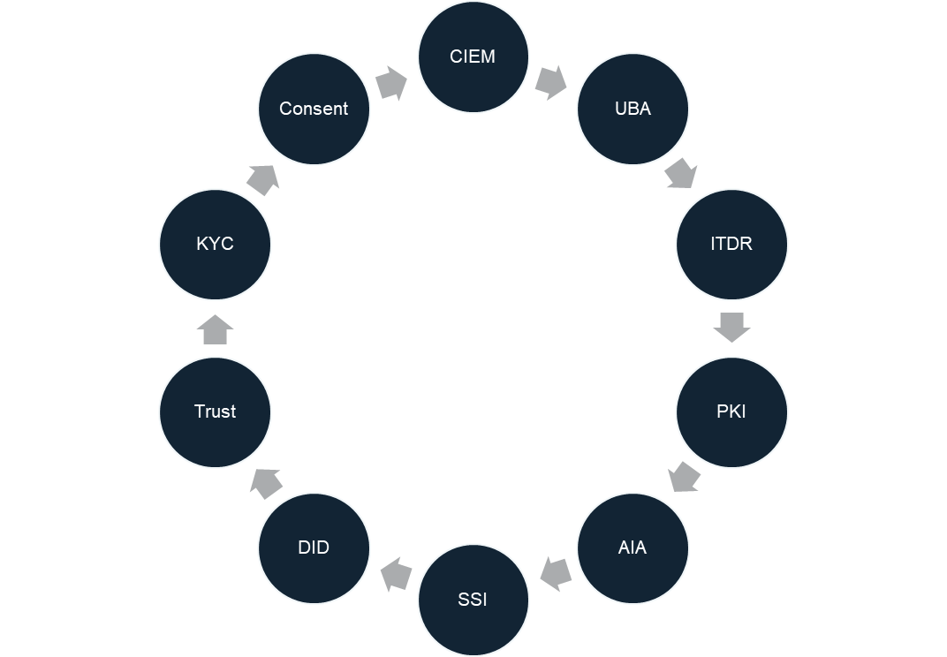

Slide 19
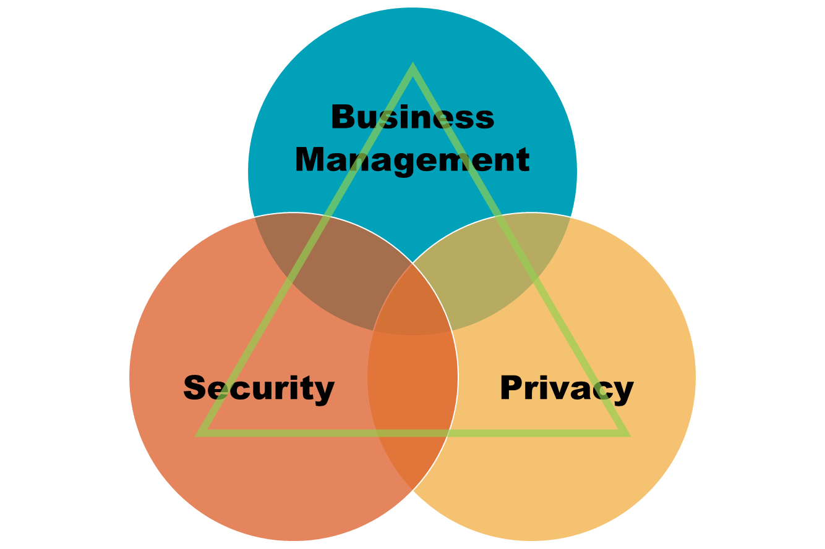

Slide 20
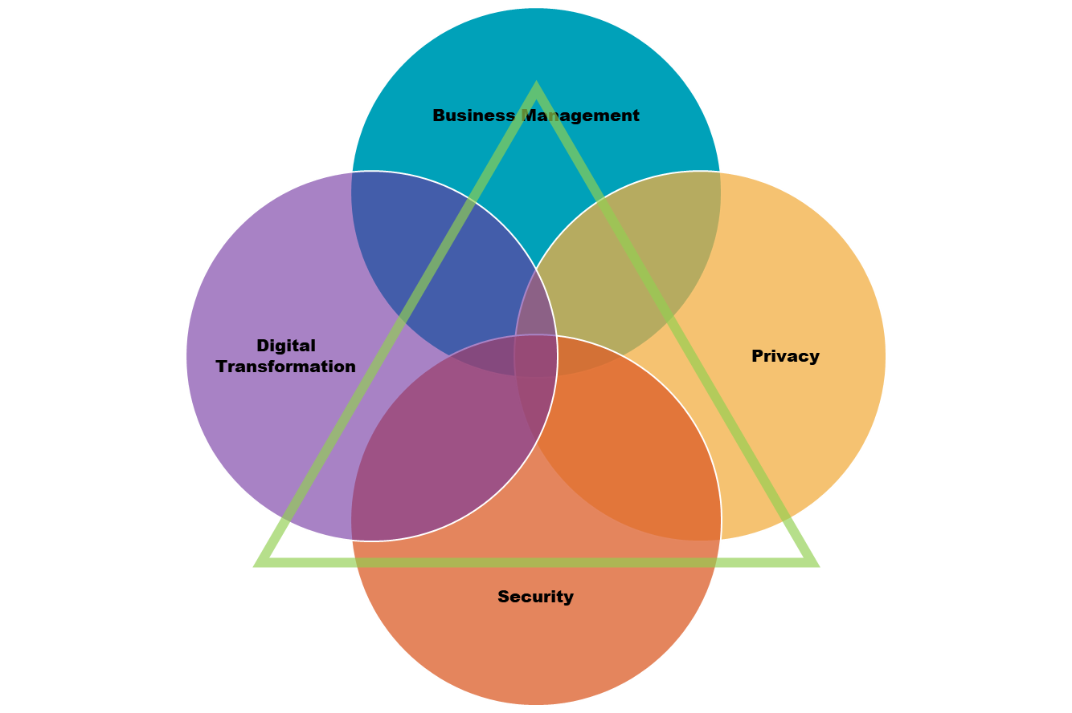

Slide 21
efficiency
digital transformation
business management
information security
..
Why?

Slide 22
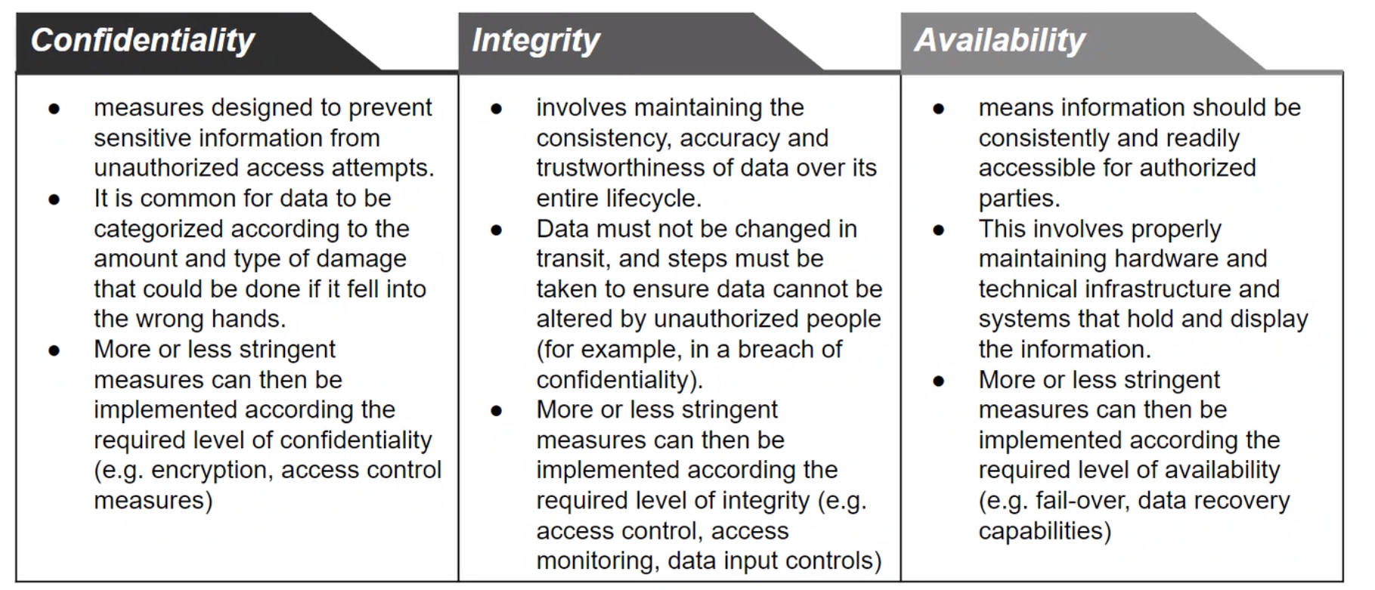
CIA perspective

Slide 23
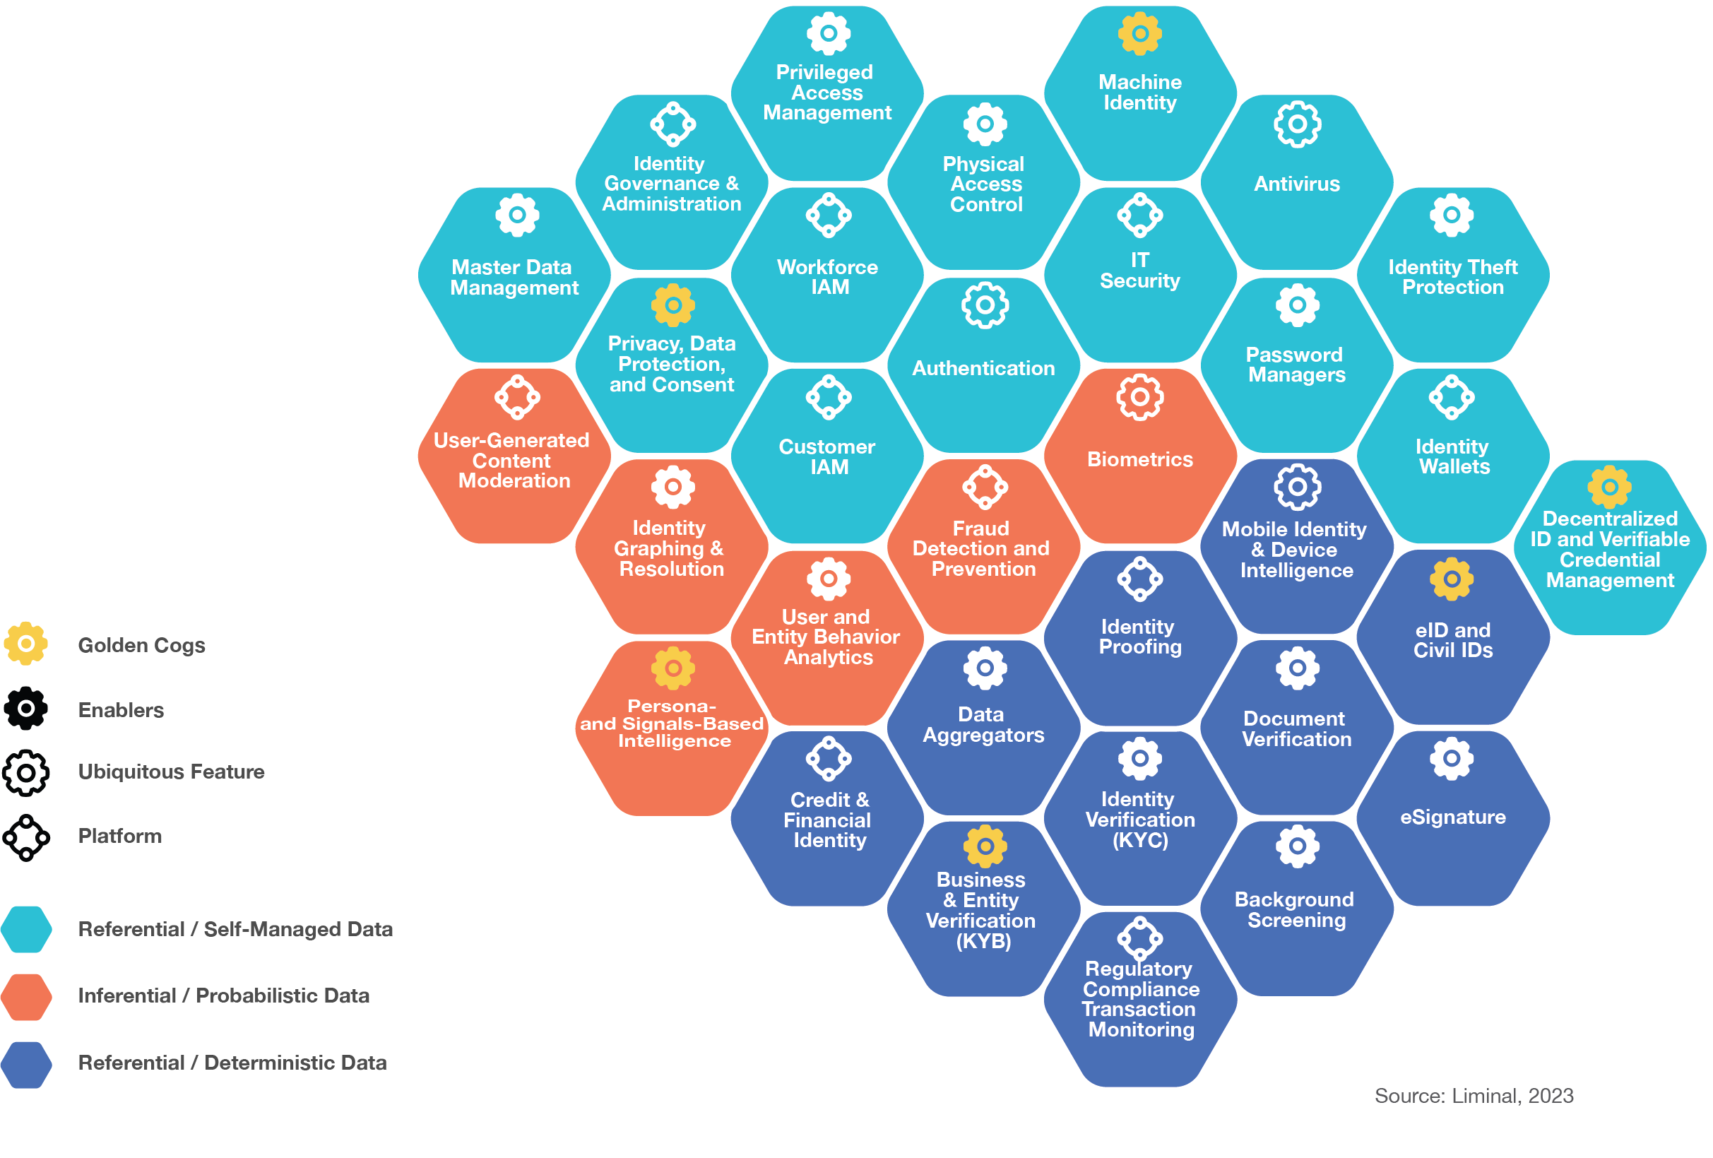
Investor or market perspective

Slide 24
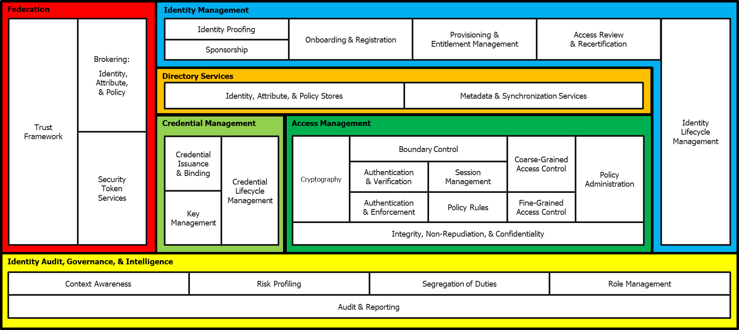
Architecture perspective

Slide 25
User accesses SaaS app
Federation
Identity Management
Trust
Framework
Brokering:
Identity, Attribute,
& Policy
Identity Proofing
Onboarding & Registration
Provisioning &
Entitlement Management
Access Review
& Recertification
Identity
Lifecycle Management
Sponsorship
Directory Services
Identity, Attribute, & Policy Stores
Metadata & Synchronization Services
Credential Management
Access Management
Security
Token
Services
Credential Issuance
& Binding
Credential Lifecycle Management
Cryptography
Boundary Control
Coarse-Grained Access Control
Policy Administration
Authentication
& Verification
Session Management
Key Management
Authentication
& Enforcement
Policy Rules
Fine-Grained Access Control
Integrity, Non-Repudiation, & Confidentiality
Identity Audit, Governance, & Intelligence
Context Awareness
Risk Profiling
Segregation of Duties
Role Management
Audit & Reporting

Slide 26
Process perspective
Validation
Authentication
Authorization
Access!
(Granted or denied)
Notes:
Overall.
But we can go a little deeper:

Slide 27
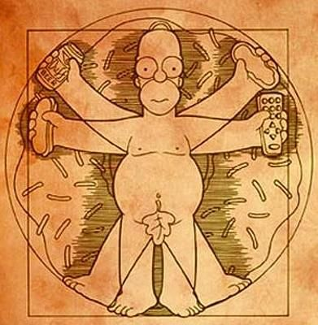
What if there’s a robot, machine or some other inhuman thing in between here?
Passwords here (until they aren’t..)
ABAC, Access Control ++
For AuthZ we often need to do more lookups for additional data from the swarm
Consent
Delegation
«on behalf of»
KYC
Manual or
automatic
fact checking
Validation
AutheNtication
AuthoriZation
«I have permission»
Results in a swarm of registered data
Make «accounts»
Make «tokens»
(for logged in sessions)
Can be used to reference/find attributes to check
But wait, there’s more! We also need: Usage data (monitoring, detection, re-checking), stronger mechanisms for high risk accesses, UX++
Notes:
I’ve been talking here mostly about functions that happen right there and then, because someone attempted to get to a value.
That «fact checking» is the most obvious part that needs to have happened already earlier.

Slide 28
Let’s structure this
The overall process you’re in uses various functions and mechanisms to achieve good enough protection.
Apart from the initial setup, the functions are executing at different places in the process.

Slide 29
Admin-time vs Run-time

Slide 30
The Process/Timeline requires preparation
The Run-time elements of AuthN and AuthZ require support and preparation.
The Admin-time elements have that job:
  Cataloguing
  Classification
  Governance
  Lifecycle
Related:
  Models for Proofing
  Models for Authorization
  Definition and identification of Privileged Access

Slide 31
When are they executed
Admin-time
In preparation or support for later functions
Potentially continuous
Huge potential for automation
Run-time
At the moment when someone attemps to access the value

Slide 32
Admin-time (aka Config-time, Design-time)
Cataloguing facts into (Directories, Repositories)
  “Sources of Truth”
Classification
  To prioritize, we need to know the difference between accesses/values
Governance
  Every function we set up should be controlled
Lifecycle
  Take the necessary actions both at the start, middle and end

Slide 33
Run-time
Authentication
  Including Federation
Authorization

Slide 34
Both?
Some are harder to place
Proofing, Validation
Analytics
  Static typically admin-time
  Event-based typically run-time
“PAM” – Handling extra-privileged access
  E.g. Secrets Management, Just-in-time elevation++
  PAM is in many ways a mini, mirror universe of Identity and Access

Slide 35
Authentication

Slide 36
Authentication
“Give me your identifier and assure me that it represents you”
The authentication function takes identifiers as input and aims produce as output:
Confirmation that supposed users are who they say they are.
(Whereas Authorization gives those users permission to access a resource, a value.)

Slide 37
Authentication
Using the established data to bind to something. Why? How?
Federation
  Collaborative / Joint Authentication
  Centralized Authentication – SSO

Slide 38
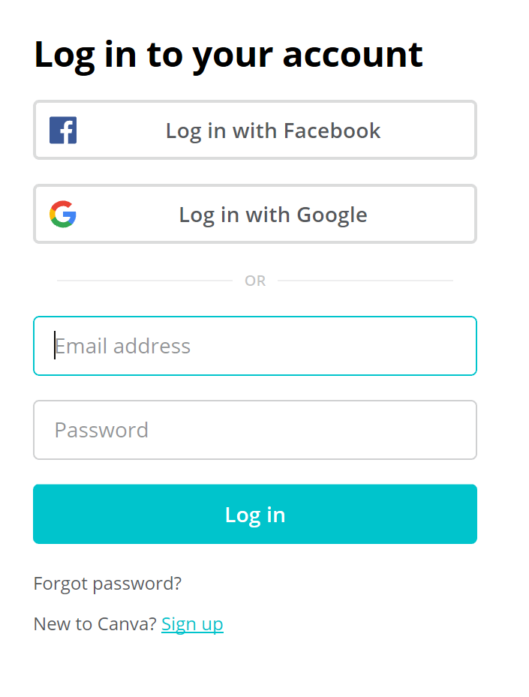
Identifiers
are not factors
Authenticators are factors
So email + password is not 2-factor
Notes:
So username/email adress + password are not 2 factors of input for an authentication function

Slide 39
Authentication: Multi-factor, Adaptive
Active (challenge) factors:
Knowledge – something (only) you know
Possession – something (only) you have
Inherence – something (only) you are
Passive (context) factors:
Location, time, behavior, patterns
Notes:
Reference BoK++ Nishant, Dean, Khaled

Slide 40
But what about
Password managers
Passkeys
Notes:
Reference BoK++ Nishant, Dean, Khaled

Slide 41
Authorization

Slide 42
Authorization
OK, you’re authentic and legit – but where can you go?
  Access all areas
Principle of least privilege (impossible in practice – why?)
What data do authorization checks require?
How do we implement this?
Authorization decisions
  If there is a rule (policy) to follow – is it evaluated by a human or by code?
  Good and bad access policies

Slide 43
Authorization models, standards and frameworks
Model: abstract approach to implementing authorization e.g. ACL, RBAC, and ABAC.
Standard: a formally approved set of specifications that define how to address authorization e.g. SAML, XACML, OAuth(!)
Framework: a technical implementation that handles authorization without being a standard itself e.g. Ruby cancancan, OPA, Oso’s Polar, Google’s Zanzibar or AWS’ Cedar.
David Brossard - https://idpro.org/the-state-of-the-union-of-authorization

Slide 44
Delegation
OAuth2
GNAP

Slide 45
Governance

Slide 46
Governance of Identity
Workforce, Contractors, Partners/Businesses, Customers..
Sources of Truth
  Identity Repository, Account Directory, etc
Entitlement Management
Access request, approval and re-approval
Roles
Policies
Audit and reporting
Lifecycles of all of the above

Slide 47
Sources of «Truth»
An authoritative place to go where you can learn about a person
B2E: HR
B2B: the partner's HR, a delegated admin, their federation service
B2C: the individual, their social persona, a government (G2C)
B2B2C
Notes:
May have multiple / may require multiple
Assume data quality is not awesome

Slide 48
User Provisioning & Lifecycle Management
Creates, Maintains, and Removes objects such as user accounts in managed systems
Automatable by events from sources of truth: Join / Move / Leave
Can assign or remove permissions, entitlements such as group membership, roles, and profiles for authorization purposes

Slide 49
User Provisioning: Continued
Can have approval processes associated with creation and changes to user accounts
Relies on connectivity to managed systems
That doesn't have to be fully automated... could be a manual process driven via a help desk ticket
Relevant standard: SCIM (System for Cross Domain Identity Management)

Slide 50
Entitlement Management
Applications have permissions such as "create purchase order"
Permissions often get aggregated into entitlements for easier management
Entitlements include groups, technical roles, business roles, profiles, permission sets
Instead of assigning people individual permissions they are often assigned entitlements

Slide 51
Entitlement Mgt: Continued
Entitlement Management involves the cataloging of assignable entitlements
Adding meaningful descriptions
Adding "owners"
Mapping entitlements to job responsibilities or types of users
"Purchasing clerks get these groups"
"Tier 1 Partners get this profile"
Often necessarily pre-work before doing segregation of duties analysis and enforcement

Slide 52
Role Management
Individual entitlements can become hard to manage
They can get aggregated into roles of 2 flavors:
  Business roles = job responsibilities
  Technical roles = collections of lower-level entitlements to enable access
Roles, especially business roles, can be mapped to HR job codes and positions
As well as partner classifications
Entitlements within a role need on-going review
Assignment rules that map roles to people need on-going review

Slide 53
RBAC – ABAC – PBAC + +
“X” Based Access Control
These are all perspectives on the same thing:
The input for making a Decision about Access (granted or denied)
Notes:
Roles as the primary handle for governing access to systems and resources
Might work well in homogenous and hiererachical organizations
Doesn’t work in matrix organizations
"Role explosion" = more roles than people

Slide 54
Access Certification
On-going review of who can access what
Ideally a tool to prevent people from keeping access they no longer need
  But it only works if the certifiers have stamina and the right competency for making those decisions
Changes to entitlements can trigger reviews
Changes to job roles can trigger reviews
Risk events can trigger (scoped) reviews

Slide 55
Identity Analytics and Intelligence
Find commonalities and outliers among user populations
Group commonly assigned entitlements together as candidate roles
Identified over-privileged users and other deviations
Discovers undocumented high privileged access (HPA) rights assigned to regular, non-privileged, accounts.
Also a tool for designing better access policies.

Slide 56
Validation / Proofing
Establishes the data and the resulting data set (digital identity)
Do we trust the data? Why? How?
Decentralized Identity
Self Sovereign Identity
Verified Credentials
  mDL
  CIDPRO

Slide 57
Privileged Access

Slide 58
Privileged Access
Not a well-defined term
  PAM: A = ?
What is more privileged than the rest?
Why?
  Your business must decide
  (It probably means you must decide)
How good is your CMDB?

Slide 59
Privileged Account Management
Some user accounts are special e.g. sysadmin, root, etc
Access to accounts like these and account used for service to service integration need management too even though there isn't a single user associated with them
"Check out" access to root
Record actions users take while in a privileged state
Scramble passwords to protect special accounts

Slide 60
Other concepts

Slide 61
Recovery
Account recovery
Credential recovery
Identity recovery
Biometric recovery
If the cat’s out of the bag.. (Can everything be recovered?)

Slide 62
Assurance
A central concept in Identity and Access
How certain are we
  That a thing is what it is presented as
  That a thing is the same as the last time we trusted it
  That someone we trust (Federation) are doing the right thing
NIST Computer Security Resource Center
  Special publication: 800-63-4

Slide 63
Attack types (Security purposes)
Account Takeover
  Digital means of accessing values are vulnerable
  And harder to secure than physical?
  Because they are abstract and complex
Notes:
Ref Mitre, Cody, other attack oriented presentations

Slide 64
ITDR
Identity Threat Detection and Response
An interesting combination of functionality – is it real?
Detection is important and Security Operations Centers could be better at understanding “Identity events”
Response includes the capability to recover, for example from Identity/Access centric backups
Compare with SOAR
Notes:
Ref Mitre, Cody, other attack oriented presentations

Slide 65
CIEM
Cloud Infrastructure Entitlement Management
Cloud vs not-Cloud: How does this matter?
  Is Cloud always more complex?
  Is on-premise and legacy a «solved problem»?
Notes:
Ref Mitre, Cody, other attack oriented presentations

Slide 66

Educational and other resources
idpro.org/educational-resources/
idpro.org/body-of-knowledge/
idpro.org/cidpro/
identiverse.com/videos/
incommon.org/academy/iamonline/
pages.nist.gov/800-63-4/ (Digital Identity Guidelines)
idsalliance.org/ (Identity Defined Security Alliance)
fidoalliance.org/fido2
a professional association for identity management that exists to globally foster ethics and excellence in the practice and profession of digital identity.
Notes:
If we didn’t already:
How many here have heard about IDPro?
Could I ask those that have also joined IDPro as members to stand up?

Slide 68
Person
Physical
Identity
Digital
Accountable
Account (user object)
Comprises data
Has an identifier, probably also a password
Exist in systems
Access Rights
System specific

